Slide 1

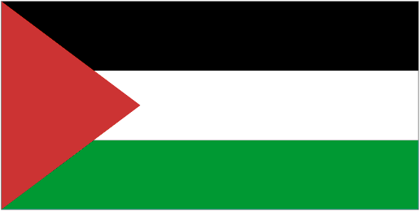

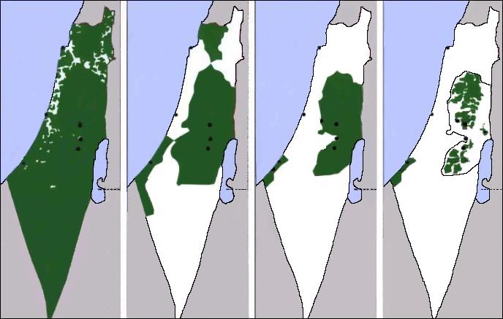
HISTORY OF
PALESTINE
IN IMAGES
Short version for the school.
Notes:
For view the presentation press : View / Slide Show / From Beginning
For advance the slide press : Page up/down.
For close the presentation click on the small window on the corner left-down and then press Exit.
For organize the automatically advance of the slide press : Slide Show /Slide Transition / Advance Slide / Automatically after x seconds / Apply to All Slides
To prepare a conference read also notes and comments at the bottom.
http://www.plands.org/graphics/index.html
http://en.wikipedia.org/wiki/History_of_Palestine
Ilan Pappe, The ethnical cleansing of Palestine
Susan Nathan, "The Other Side of Israel", ed. HarperCollins Publishers Ltd.
Shlomo Sand: The invention of the the Jewish people.
Norman G. Finkelstein: The Holocaust Industry
https://spaces.hightail.com/space/7K0i2/fi-6385ce6d-1449-47f9-a4f3-25a02da48c13/The%20Book.pdf
Fariss Wogatzki : "Möge keiner sagen, er hätte es nicht gewusst!"
This presentation can be downloaded for free and in 5 languages here: http://www.imparalavita.ch/eng/palestine_history.html

Slide 2
This presentation is simply to explain the most important historical facts of Palestine and the vicissitudes of the Palestinian people.
It should not be interpreted as an accusation against the Jews, who also suffered , nor against the people of Israel.
Persecution of the Jews culminating in the Holocaust, where 5,5 million Jews were murdered, has impacted Jewish and non-Jewish attitudes throughout the world towards Palestine.
It is very important to distinguish between Jews in general and Zionists and/or Israelis, who are directly responsible for the sufferings of the Palestinian people.
There can be no peace without justice.
Note that in the history of Palestine with the word "Jew" or "Jews" are intended Zionist Jews.
http://en.wikipedia.org/wiki/History_of_Palestine
Notes:
Contextualization.
There are two types of colonialism:
exploitation colonialism, which implies the appropriation of resources (oil, raw materials, slaves, etc.). In this case, the colonizers install a team of officials and technicians who are protected by a military contingent. Also they use a servile local bourgeoisie to export the country's resources, a classic case are the Central African countries. Strategic location can also be an asset, Gibraltar is a classic example.
settlement colonialism, which implies the conquest and occupation of the territory and settlement of the conquering country population. In this case, the colonizers take possession of the territory and all that it contains by all possible means, including force. Obviously, the indigenous population represents a major obstacle and is therefore "eliminated", means subjugated or confined in delimited areas, driven out (in the jargon "ethnic cleansed") or simply killed. A classic case is the USA where the indigenous population has been largely exterminated and the survivors locked up on Indian reservations areas.
Zionism and Israel are also a classic case of settlement colonialism. Before 1948, Zionist settlers bought some land (about 7% of Palestine) to settle there. But starting in 1948 they forcibly occupied the lands by force through cruel ethnic cleansing, brutal repression (destruction of the means of subsistence of the indigenous population), imprisonment and confinement of the indigenous population in few areas surrounded by impassable barriers (the Wall, Gaza). All these procedures are accompanied by an enormous propaganda (Holocaust, divine promise, anti-Semitism, only democracy of the ME, positive image, etc.), a great mystification of reality (historical mystifications, the oppressors becomes the victims, etc.). Every protest is brutally repressed and it becomes a pretext to occupy even more land (1. and 2. Intifada). Any act of resistance is defined as an act of terrorism and massive and bloody reprisals are carried out (Gaza). Alliances are made with other nations that also practice colonialism and repression (England, USA) and the colonizers obtain political (example in the UN), financial and military aid. In addition, the colonialists systematically eliminate local leaders and activists (3,000 prominent Palestinians were eliminated by Israeli special forces), foreign supporters of the local population (Arab countries) are corrupted or intimidated, ethnic discrimination (apartheid) and a nationalist and racist ideology are implemented, etc. They also set up a large apparatus of repression (IDF, special armed groups, secret services, prisons, surveillance system, home and infrastructure destruction, etc.). A discriminatory legislative and judicial apparatus (new cadastre, very strict laws for the indigenous population, law on return, law on absentees, etc.) etc. and a propaganda apparatus (Hasbara) are implemented.
This presentation is also the history of classic Zionist settlement colonialism in Palestine

Slide 3
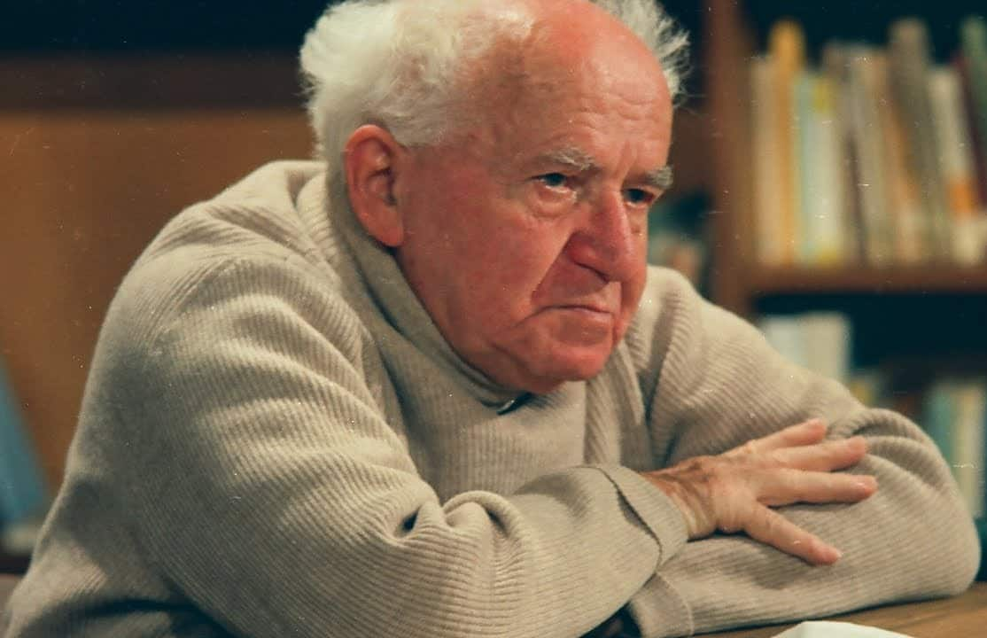
"We will drive out the Arabs and
take their place.”
A classic case of settlement colonisation
Ben Gurion 1886 - 1973
Prime Minister of Israel
1948 - 1953 and 1955 - 1963
*Ben Gurion's letter written in 1937 to his son.
It is very important to study the history of Palestine for understand what happened and is happening in Palestine (Ilan Pappe). https://www.youtube.com/watch?v=ug45Mv1eaL0
Notes:
The specious justifications put forward by Zionists:
Anti-Semitism - The Jewish people have always been persecuted (e.g. pogroms) so they must have a place to stay in safety
Historical right - Palestine was inhabited by Jews so it belongs to the Jews - Palestine was uninhabited
Divine right - Palestine was promised by God to the Jews; the Jews are the Chosen People.
Balfour Declaration, UN 181, etc. etc.
https://www.palestineremembered.com/David_Ben_Gurion_To_His_Son_Amos_Written_OCT_5th_1937.html

Slide 4
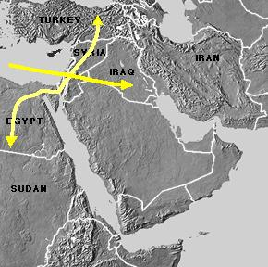
PALESTINE
The only route between
Africa and Asia
Africa and Europe
the Mediterranean sea and the Orient
ARABIA
It should be noted that in this part of the presentation the word Palestine is understood as a geographical region and that some of the landscapes represented are today in that part of Palestine called Israel.
http://en.wikipedia.org/wiki/The_Levant
Notes:
http://en.wikipedia.org/wiki/The_Levant
http://it.wikipedia.org/wiki/Palestina

Slide 5
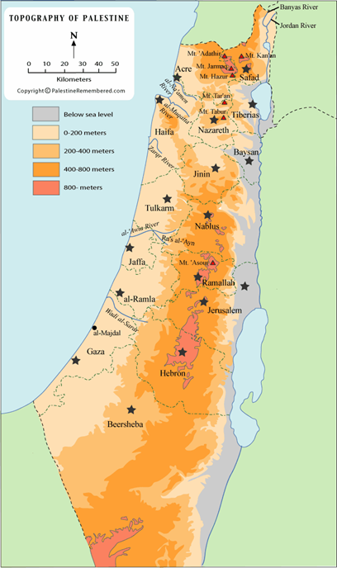
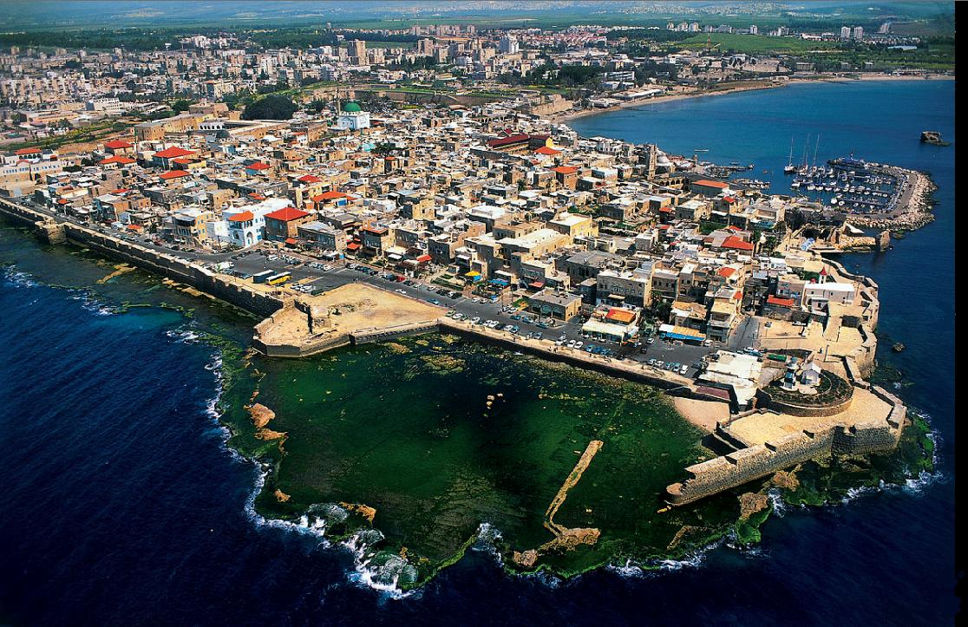
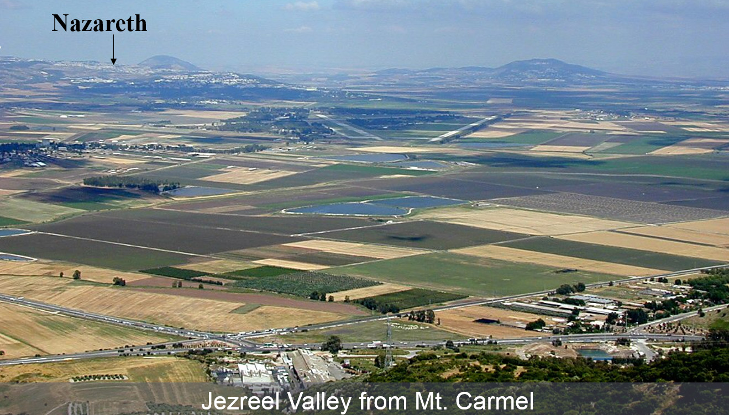
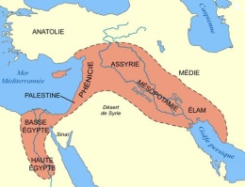
Lebanon
Syria
Golan
Jezreel Valley
Mediter-ranean see
Acre
Jordan
Jericho
PALESTINE
The topography shows the fertile coastal plain, irrigated by the water that flows down from the mountains
Mar Morto
The fertile crescent of the ME
Egypte
Sinaï
Notes:
http://en.wikipedia.org/wiki/Fertile_crescent
https://en.wikipedia.org/wiki/Jezreel_Valley
https://en.wikipedia.org/wiki/Acre,_Israel

Slide 6
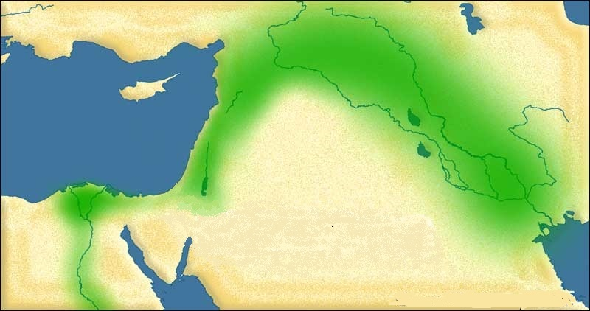
TURCHIA
SIRIA
IRAQ
IRAN
LIBANO
PALESTINA
EGITTO
ARABIA SAUDITA
The fertile crescent of the Middle East
There is arable land and water in abundance.
https://en.wikipedia.org/wiki/Fertile_Crescent
Notes:
https://en.wikipedia.org/wiki/Fertile_Crescent

Slide 7
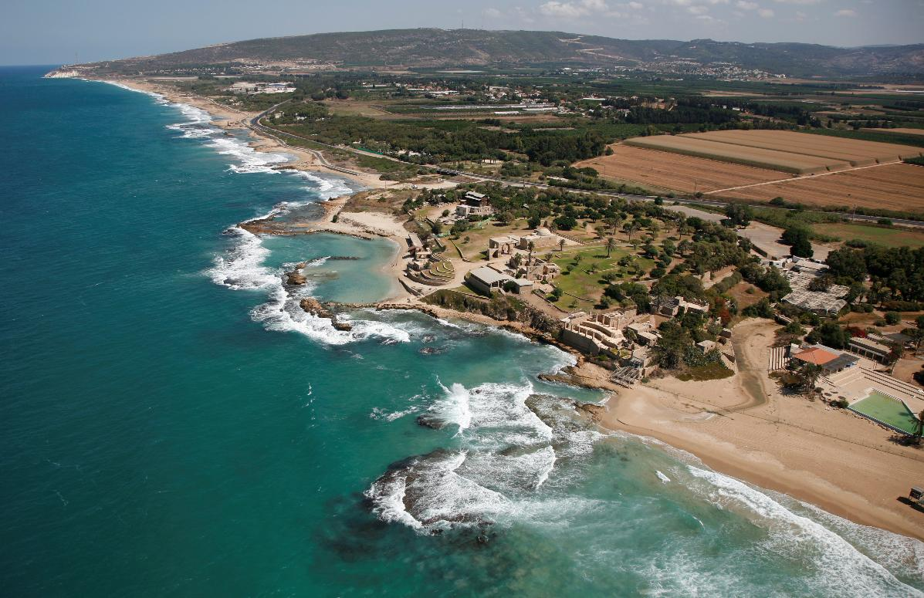
The Nord coast of Palestine
Notes:
.

Slide 8
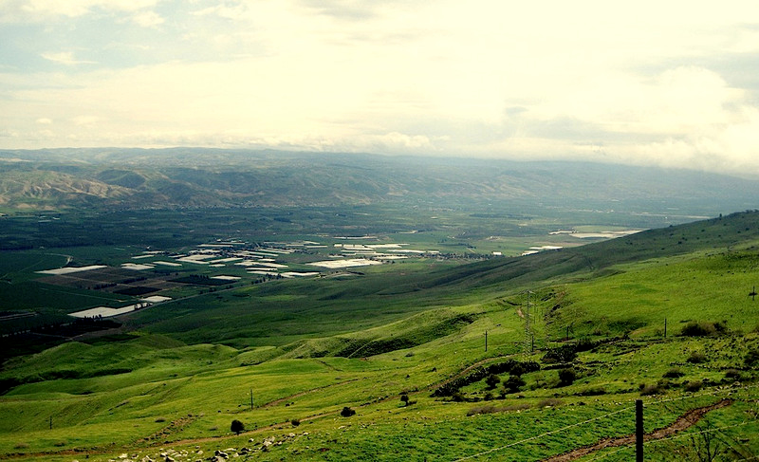
The Jordan Valley
In the background the plateau of Jordan. The white spots are the greenhouses of the Israeli colonies.
https://en.wikipedia.org/wiki/Jordan_Valley
Notes:
https://en.wikipedia.org/wiki/Jordan_Valley

Slide 9
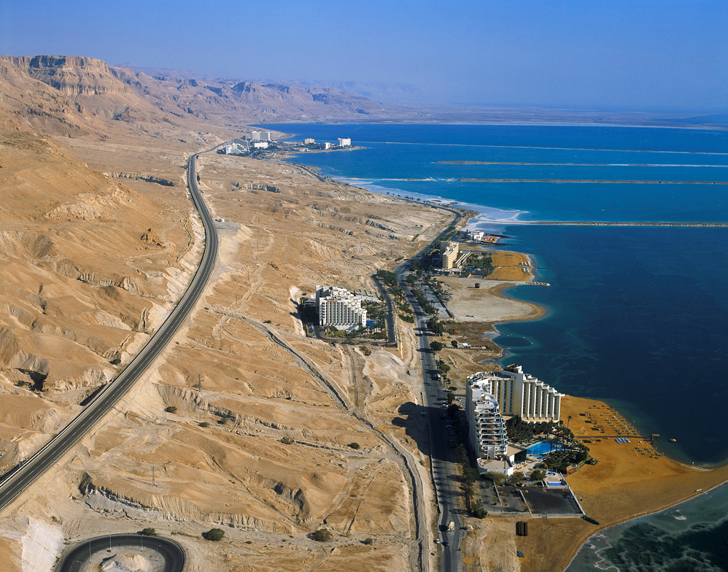
The Israelis exploit Palestinian land for tourism purposes.
Dead Sea
Notes:
http://en.wikipedia.org/wiki/Dead_Sea
http://deadseahotels.org/

Slide 10
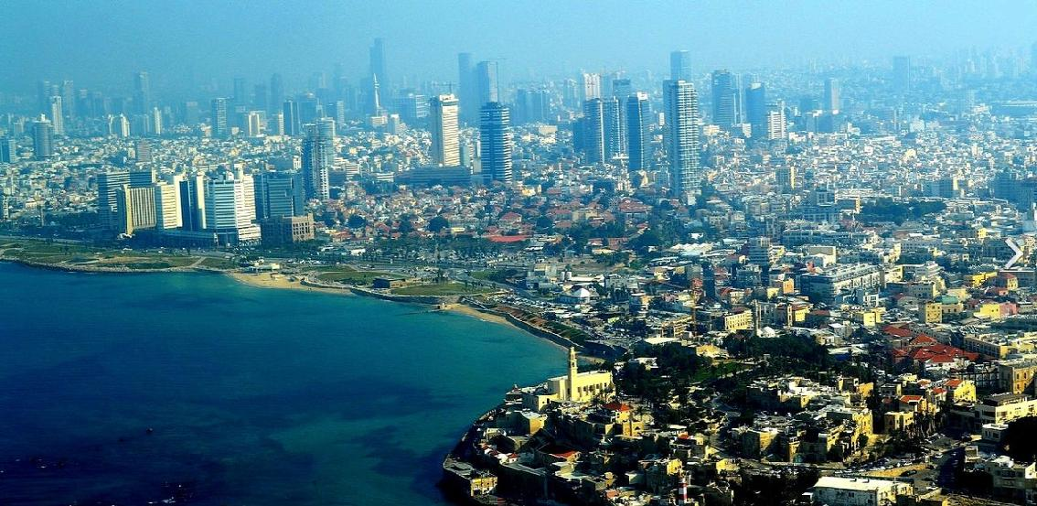
Tel Aviv today
What’s remain of Jaffa.
https://en.wikipedia.org/wiki/Tel_Aviv
Notes:
https://en.wikipedia.org/wiki/Tel_Aviv

Slide 11
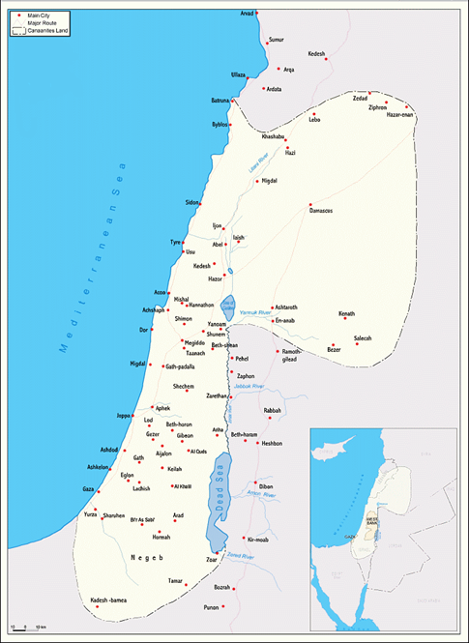

The town of Jericho was founded 7000 years ago
The Cananeans, first inhabitants of Palestine about 5000 years ago.
(3000 BCE - 1468 BCE)
http://en.wikipedia.org/wiki/Canaan
Notes:
Around 7000 years ago, the Cananeans founded the town of Jericho.
http://en.wikipedia.org/wiki/Canaan
https://www.abc.net.au/news/science/2017-07-28/ancient-dna-shows-canaanites-survived-biblical-slaughter/8749264

Slide 12
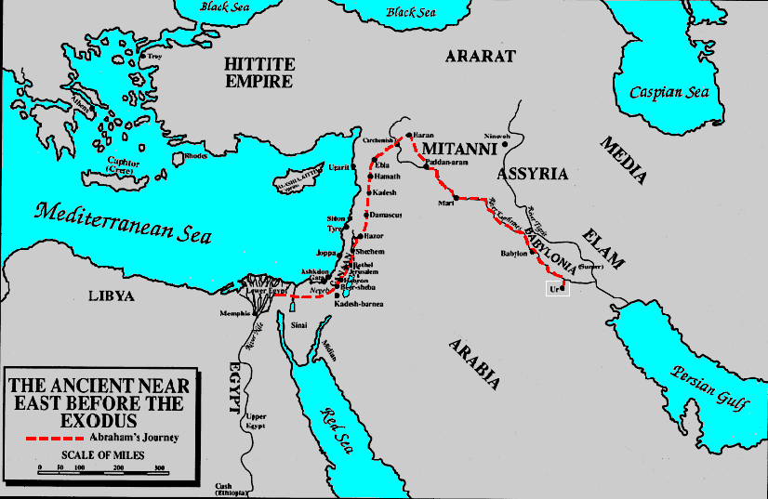
Attention: biblical version
1800 B.C.E - On the way to Egypt Abraham/Ibrahim passes through Palestine.
Notes:
http://en.wikipedia.org/wiki/Avraham
http://en.wikipedia.org/wiki/Lech-Lecha

Slide 13
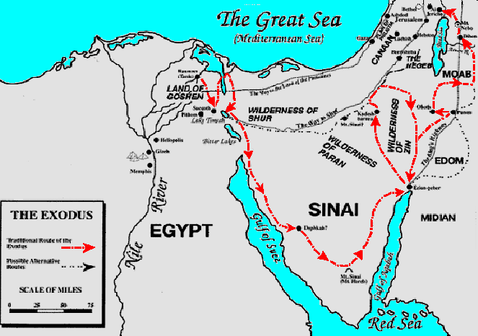
Attention: biblical version
About 1250 B.C.E The Jews escaped from Egypt and returned to Palestine
In Palestine the Jews battled many Cananeans and Philistines, who also arrived at a similar period. The Jewish priests of the time stated that Palestine had been promised to them by God.
Notes:
This here up is the biblical version refuted by some modern researchers and historians.
According to some modern claims there wasn’t an exodus but only an escape of small groups of opponents of the Pharaonic regime, (scripture says different) groups that joined the existing Canaanite tribes in Palestine.
But according to scripture, there was an exodus, but the nature of the people diverged, yet the promise remained true for several branches of the monotheist family.
Shlomo Sand: “The Invention of the Jewish People"
See also: Israel Finkelstein y Neil Asher Silberman, "La bible dévoilée" (The Bible revealed).
See also: Eran Elhaik
https://www.darkmoon.me/2015/the-first-jewish-lie-the-old-testament-fabrication-that-the-israelites-were-slaves-in-egypt-john-kaminski/
+++++++++++++++++++++++++++++++++++++++++++++++++++++
The Bible came from Arabia – Kamal Salibi – Pan Books – Radical reinterpretations of old testament geography
According to lebanese historical researcher Kamal Salibi, the ancient Jews did not settle in Palestine but in the Arabian peninsula.
https://drive.google.com/file/d/1ZBY-kpYj6JVHggreOmcgt-jTzApWRZ7U/view
https://en.wikipedia.org/wiki/Philistia
https://en.wikipedia.org/wiki/Phoenicia
https://en.wikipedia.org/wiki/Ekron

Slide 14
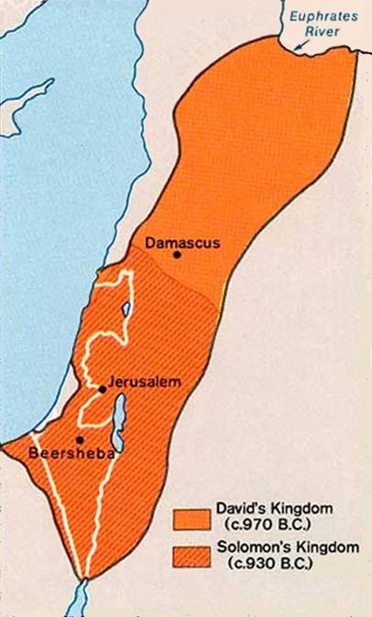

Phoenicians
The Jews in Palestine
The David’s Kingdom (970 B.C.)
and the Solomon’s Kingdom (930 B.C.)
(According to some modern researchers the Jewish kingdoms were only small tribal domains and Jerusalem just little more of a village)
Philistines
Gaza
Notes:
http://en.wikipedia.org/wiki/Israelites#Biblical_Israel
http://simple.wikipedia.org/wiki/History_of_ancient_Israel_and_Judah
http://en.wikipedia.org/wiki/Kingdom_of_David
https://www.jehovahs-witness.com/topic/140884/kingom-david-never-existed
https://theologygateway.info/menu-main-biblical-theology/old-testament-maps/107-palestine-from-720-bc-to-the-exile-of-judah-586-ff#google_vignette
http://en.wikipedia.org/wiki/Kingdom_of_Israel_and_Judah
Shlomo Sand: The Invention of the Land of Israel: From Holy Land to Homeland Hardcover – Nov. 20 2012
http://en.wikipedia.org/wiki/Assyrian_empire
http://simple.wikipedia.org/wiki/History_of_ancient_Israel_and_Judah
THE INVENTION OF ANCIENT ISRAEL. The Silencing of Palestinian History by Keith W. Whitelam.
The Invention of the Land of Israel: From Holy Land to Homeland Hardcover – Nov. 20 2012
https://www.darkmoon.me/2015/the-first-jewish-lie-the-old-testament-fabrication-that-the-israelites-were-slaves-in-egypt-john-kaminski/
by Shlomo Sand (Author), Geremy Forman (Translator)
What is a homeland and when does it become a national territory? Why have so many people been willing to die for such places throughout the twentieth century? What is the essence of the Promised Land? Following the acclaimed and controversial The Invention of the Jewish People, Shlomo Sand examines the mysterious sacred land that has become the site of the longest-running national struggle of the twentieth and twenty-first centuries.
The Invention of the Land of Israel deconstructs the age-old legends surrounding the Holy Land and the prejudices that continue to suffocate it. Sand’s account dissects the concept of “historical right” and tracks the creation of the modern concept of the “Land of Israel” by nineteenth-century Evangelical Protestants and Jewish Zionists. This invention, he argues, not only facilitated the colonization of the Middle East and the establishment of the State of Israel; it is also threatening the existence of the Jewish state today.
According to researchers Israel Finkelstein and Neil Asher Silberman, "The Bible revealed," the contact between the Jewish priesthood deported to Persia with religion and Persian culture has generated a new culture and a monotheistic religion containing innovation that the Jewish clergy subsequently imported into Palestine and spread in the ancient world
Shlomo Sand: “The Invention of the Jewish People"
See also: Israel Finkelstein y Neil Asher Silberman, "La bible dévoilée" (The Bible revealed).
See also: Eran Elhaik
See also: Steven Rudd – Exodus Route Restored
https://en.wikipedia.org/wiki/Philistia
https://en.wikipedia.org/wiki/Phoenicia
https://en.wikipedia.org/wiki/Ekron

Slide 15
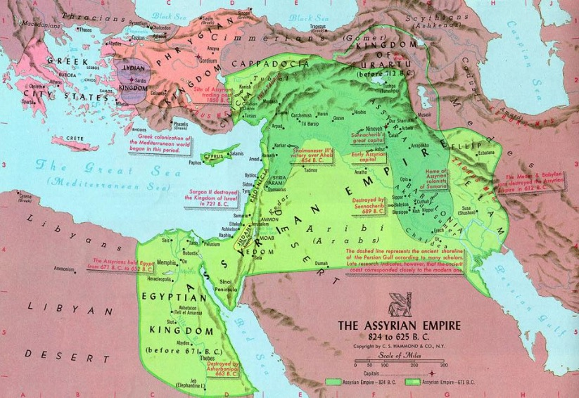
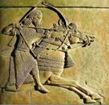


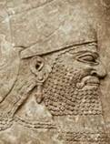
Mesopo-tamia
Assurbanipal
733-721 B.C.E - The Assyrian
The Assirian, people of Mesopotamia, defeated the Jews of Israel’s kingdom and deported many of them to Mesopotamia.
http://en.wikipedia.org/wiki/Assyrian_empire
Notes:
http://en.wikipedia.org/wiki/Assyrian_empire

Slide 16
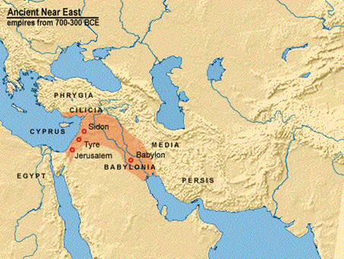
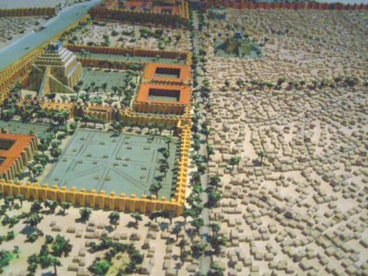

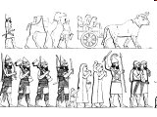
The Babylonian empire
A model of the city of Babylon
597 B.C.E - The Babylonians
The Babylonians, people of Mesopotamia and successors of the Assyrians (today’s Iraqis) - also conquered the kingdom of Judea, destroyed the first
temple and deported many Jews to Babylon.
The deportation of the Jews
http://en.wikipedia.org/wiki/Babylon_Empire
Notes:
http://simple.wikipedia.org/wiki/Babylon
http://en.wikipedia.org/wiki/Babylon_Empire

Slide 17
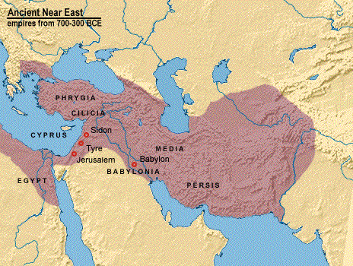
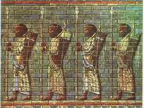

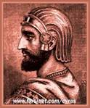
Persian empire
Cyrus
http://en.wikipedia.org/wiki/Persian_Empire
539 B.C.E. - Cyrus the Persian
In the year 539 B.C.E, Cyrus, the Persian, set the Jews free, but only the Judean tribe returned to Palestine which subsequently was dominated by the Persians (today Iranians). At that time a smaller temple was built. According to some modern researchers the origin of certain practices within certain sects of Judaism dates from this period.
Notes:
According to researchers Israel Finkelstein and Neil Asher Silberman, "The Bible revealed," the contact between the Jewish priesthood deported to Persia with religion and Persian culture has generated a new culture and a monotheistic religion containing innovation that the Jewish clergy subsequently imported into Palestine and spread in the ancient world
http://en.wikipedia.org/wiki/Persian_Empire
http://en.wikipedia.org/wiki/Cyrus_the_great
http://en.wikipedia.org/wiki/Persepolis

Slide 18
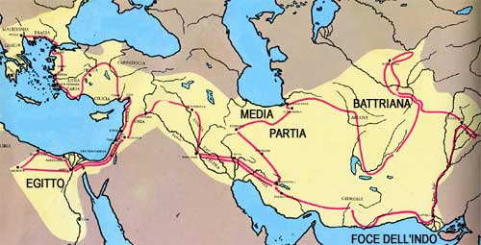
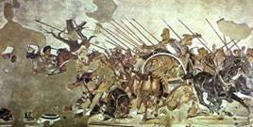
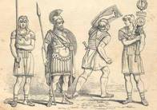
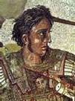
322 B.C.E. - The Macedonians (Greeks)
Palestine was domineted by the Macedonians led by Alexandre the Great who built a vast empire. The hellenic influence continued until the first century B.C.E
http://en.wikipedia.org/wiki/Macedonian_Empire#Empire
Notes:
http://en.wikipedia.org/wiki/Macedonian_Empire#Empire
http://en.wikipedia.org/wiki/Alexander_the_Great

Slide 19
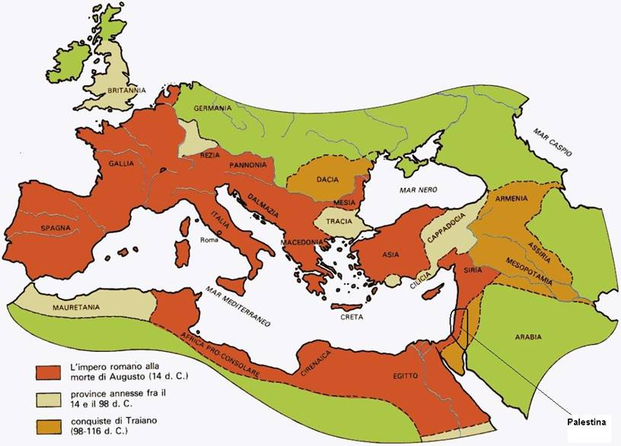


The Roman empire between 14 and 116 A.D.
http://en.wikipedia.org/wiki/Roman_empire
Notes:
http://en.wikipedia.org/wiki/Roman_empire
According to new research in the field of the biology and the archaeology, it was discovered that the Romains killed, kidnapped or chased away few Jews only. The majority of the Jews stayed in Palestine and in the next centuries they were converted to the other religions. The successors of these Jews are today the Palestinians.
By a marked Jewish proselytism before and after Jesus Christ some peoples or groups were converted to the Jewish religion (Khazares, Berbers, are Yemenite, Falascià étiopians, etc.). They had no connection with Palestine although today, under the flag of the Zionism and the Holocaust, they claim Palestine for themselves.
Source :
Shlomo Sand : „ The invention of the Jewish people “
Israel Finkelstein and Neil Asher Silberman «the bible unearthed»
See also Eran Elhaik
http://en.wikipedia.org/wiki/Roman_empire
http://en.wikipedia.org/wiki/Byzantine_Empire

Slide 20
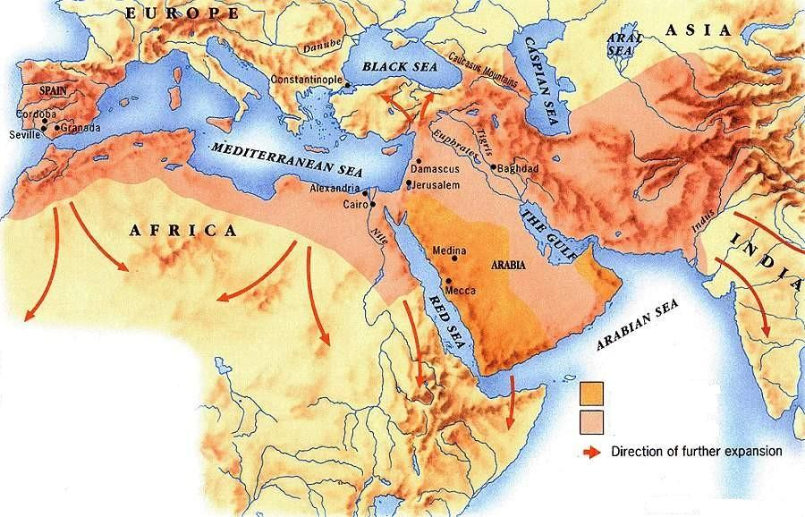
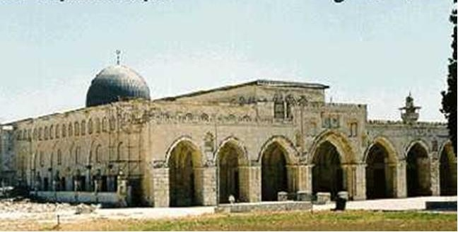

Al - Aqsa Mosque, Jerusalem
Captured by Mahomet
Captured in the following 100 years
From 637 A.D. Palestine is part of the Islamic world
https://en.wikipedia.org/wiki/Muslim_history_in_Palestine
Notes:
http://en.wikipedia.org/wiki/Islam
http://en.wikipedia.org/wiki/Al-Aqsa_Mosque
https://en.wikipedia.org/wiki/Muslim_history_in_Palestine

Slide 21
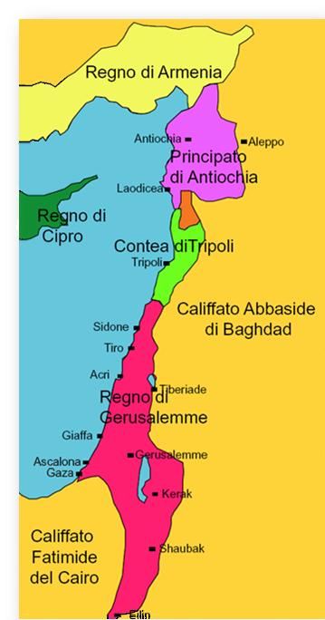
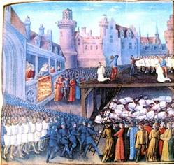


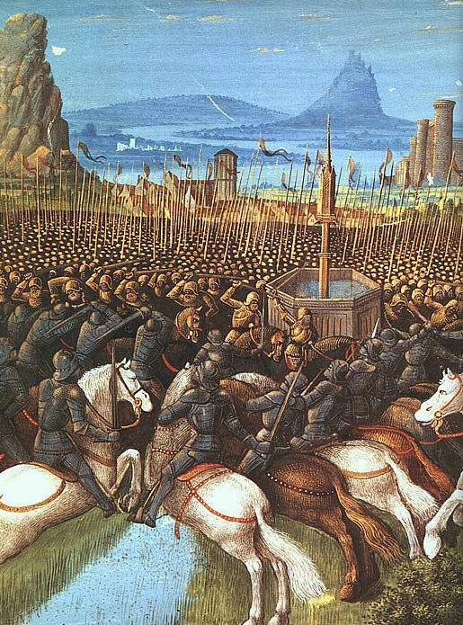
Palestine at the time of the Crusaders About 1200 A.D.
Kingdom of Jerusalem
The battles and the massacres perpetrated by Crusaders
Notes:
http://en.wikipedia.org/wiki/The_Crusades
http://en.wikipedia.org/wiki/Richard_Lionheart
http://en.wikipedia.org/wiki/Massacre_at_Ayyadieh

Slide 22
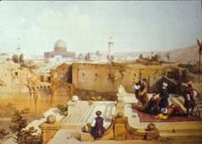
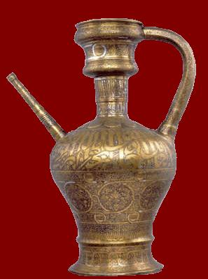
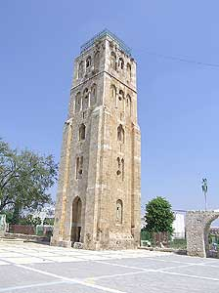
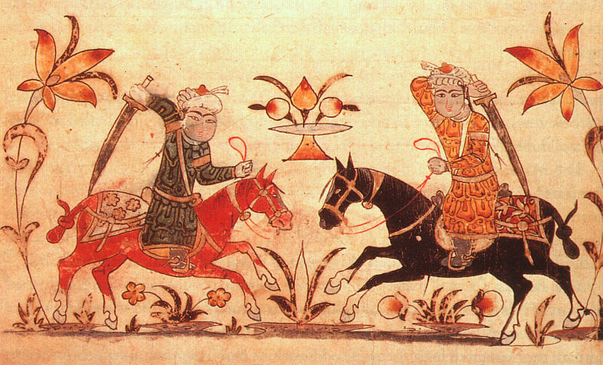
1253 - 1516
Palestine is dominated by the Mamelukes islamic warriors.
Notes:
http://en.wikipedia.org/wiki/Mameluke_Sultanate

Slide 23
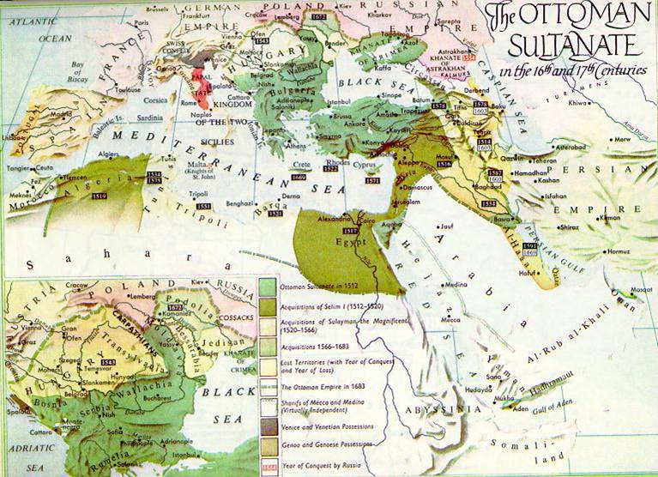
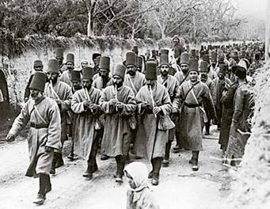
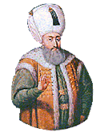
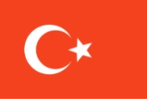
Suleiman the Magnificent
https://en.wikipedia.org/wiki/Ottoman_Empire
From 1516 to 1917 Palestine is part of the Ottoman Empire
Photo: Ottoman soldiers. Map: the Ottoman Empire between 1600 and 1700
Notes:
http://en.wikipedia.org/wiki/Suleiman_the_Magnificent
https://en.wikipedia.org/wiki/Ottoman_Empire

Slide 24
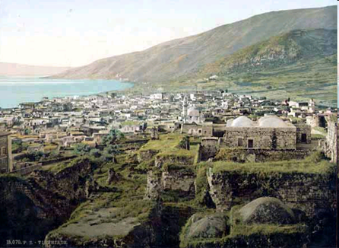
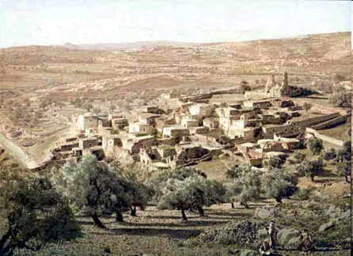
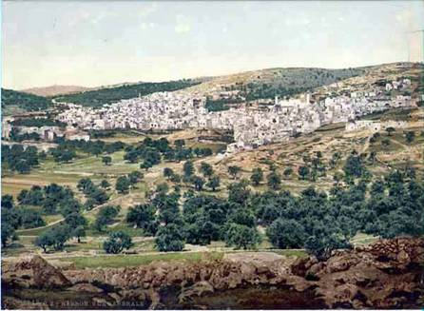
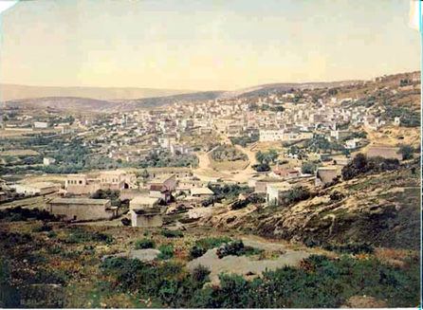
Tibériade
Béthanie
Palestine: around the end of 1800
Hébron
Nazareth
Notes:
In 1800 Palestine had about 300’000 inhabitants.
A portion of the land was owned collectively. The Turkish land reform, whose purpose was to tax land ownership, forced the farmers to record their land in the name of Turkish or Lebanese great landowners, but retaining the right to live there and working. Later some great owners sold the land to the Zionists that expelled the Palestinian farmers. This affects only a small part of Palestine.
http://en.wikipedia.org/wiki/Tiberias
http://en.wikipedia.org/wiki/Bethany_(Israel)
http://en.wikipedia.org/wiki/Hebron
http://en.wikipedia.org/wiki/Nazareth
http://en.wikipedia.org/wiki/Jericho
http://en.wikipedia.org/wiki/Betlehem

Slide 25
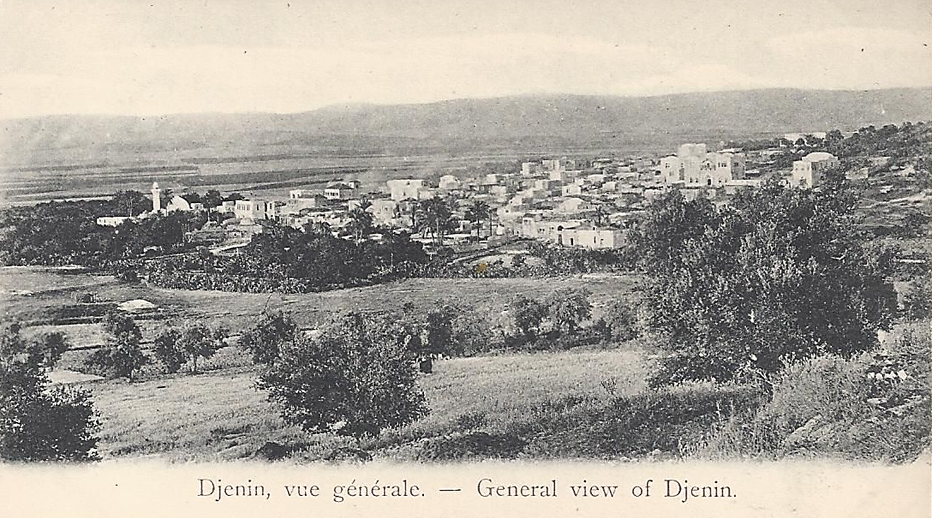
Jenin, about 1900
Palestine: a land without people?
Notes:
https://en.wikipedia.org/wiki/Jenin

Slide 26
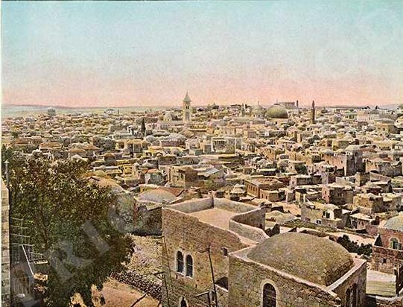



Jerusalem: year 1895
Notes:
Note the turkish flag, up right side
http://en.wikipedia.org/wiki/Jerusalem

Slide 27








Palestine : the Holy Land for three important monotheistic religions
Muslims on the terrace at Al Aqsa
Christian Holy Sepulcre Church in Jerusalem
Torah Bible Quran
Jews at the Wailing Wall in Jerusalem
Notes:
http://en.wikipedia.org/wiki/Palestine/Christian
http://en.wikipedia.org/wiki/Haredim
http://en.wikipedia.org/wiki/Torah
http://en.wikipedia.org/wiki/Koran
http://en.wikipedia.org/wiki/Temple_Mount
http://en.wikipedia.org/wiki/Wailing_wall
https://en.wikipedia.org/wiki/Muslim_history_in_Palestine

Slide 28



Jews in Palestine in front of their vine farm in 1860
In Palestine, Jews are 5% of the population
The religious jews
1882 Some of the first Zionist immigrants arrived from Russia und Rumania
Notes:
The first Jews immigrated to Palestine for religious reasons and they integrated well with the local population.
Their presence will affect the choices of the Zionist Congress in Basel in 1897.
http://en.wikipedia.org/wiki/Jews_of_Palestine
http://en.wikipedia.org/wiki/Rishon_LeZion
https://en.wikipedia.org/wiki/Mizrahi_Jews
https://en.wikipedia.org/wiki/Sephardi_Jews
https://en.wikipedia.org/wiki/Ashkenazi_Jews

Slide 29




The Templars in Jerusalem, supported by Willhelm II. Kaiser of Germany
The German Templar colony in Haifa 1877
1800 - 1900
Some christian religious orders settle in Palestine.
Also some Jews buy land in Palestine and settle there for religious reasons.
All give a strong boost to the Palestinian economy.
1880 - The Imperial Orthodox Palestine Society school in Beit Jala
Bethlehem : Church of the Nativity and the annexe buildings of the Franciscan friars
Notes:
After the 1883 Berlin conference the European countries accelerated the colonialization of Africa and Asia
http://en.wikipedia.org/wiki/Kaiser_Wilhelm_II
http://en.wikipedia.org/wiki/Church_of_the_Nativity
http://en.wikipedia.org/wiki/Templers_(religious_believers)
http://en.wikipedia.org/wiki/German_Colony,_Haifa
http://www.jstor.org/stable/40694582?seq=1#page_scan_tab_contents

Slide 30








Theodor Herzl
Chaim Weizman, President of the Zionist organisation
Basel
1897 - The beginning of Zionism
In Basel (Switzerland) the first Zionist congress presided over by Theodor Herzl proposes to establish in Palestine a State for the Jews. The options of Uganda and Argentina were rejected.
The purchase of land and the shipment of settlers to Palestine begins.
In order to raise the money, in 1901 the Jewish National Fund was founded.
The invitation to the first congress (with Wailing Wall)
The contribution certificate
Notes:
On the first platform the Wailing wall was already embodied : the intention to settle in Palestine and not in an other country was clear since the beginning.
Basel in Switzerland was chosen because, in Germany, Zionism was considered wrong by the majority of Jews.
Theodor Herzl, founder of the Zionist movement talking about the Arabs of Palestine in 1895: "Drive the poor people across the border by refusing them work. The process of expropriation and displacement of the poor must be conducted discreetly and with caution. "
http://en.wikipedia.org/wiki/History_of_Zionism
http://en.wikipedia.org/wiki/Jewish_National_Fund
http://en.wikipedia.org/wiki/Zionism_is_racism
http://en.wikipedia.org/wiki/Haredim_and_Zionism
https://www.livescience.com/40247-ashkenazi-jews-have-european-genes.html
https://www.routledge.com/Sociological-Knowledge-and-Collective-Identity-S-N-Eisenstadt-and-Israeli/Sinai/p/book/9781138351837
https://en.wikipedia.org/wiki/Saul_Raphael_Landau
https://en.wikipedia.org/wiki/Israel_Zangwill
https://en.wikipedia.org/wiki/Israel_Zangwill#References
https://en.wikipedia.org/wiki/Jewish_Territorial_Organization
https://en.wikipedia.org/wiki/Jewish_Colonisation_Association

Slide 31





The Semites
The Jews
The Zionists
Mizraim Jews: Middle Eastern Jews descended from Abraham. They are Semites.
Sephardi Jews: Iberian Jews.
Ashkenazi Jews: Jews of European origin. They are the majority group.
People, mostly Jews, who want to create a Jewish-only nation, preferably in Palestine.
Zionism is a form of nationalism and racism.
Peoples of the Middle East descended from Shem, 3. son of Noah.
Anti Zionists
People, including Jews, who oppose Zionism.
Arabs, Palestinians and Mizraim Jews are Semites.
Jews are a religious community.
Notes:
Anti-Zionist Jews believe that Jews must atone for God's curse by remaining scattered around the world. The creation of a nation of the Jews is therefore contrary to the Hebrew scriptures according to which only the Messiah who will come can indicate to the Jews where they can create their nation.
https://en.wikipedia.org/wiki/Semitic_people
https://en.wikipedia.org/wiki/Mizraim
https://en.wikipedia.org/wiki/Sephardi_Jews
https://en.wikipedia.org/wiki/Ashkenazi_Jews
https://www.nkusa.org/
The invention of the Jewish people - Shlomo Sand

Slide 32









Galilea 1913
Orange harvesting in Jaffa 1915
Kibbuz Ramat Babel 1927
Early 20th century : the first zionist pioneers arrives
Kefar Giladi 1916
Kibbuz Rishon Le Zion 1913
Galilea 1913
The first jewish quarter in Haïfa 1907
First haus in Rehavia near Jerusalem
Galilea 1913
Notes:
The style of dwellings are Russian as many Jews came from Russia.
http://en.wikipedia.org/wiki/Sionist
http://en.wikipedia.org/wiki/Hashomer

Slide 33

In 1839 the Turkish Ottoman Empire begins a modernization programme, and this includes Palestine.
1914 - The Turkish Ottoman Empire
http://en.wikipedia.org/wiki/Ottoman_Empire
Notes:
Today the Zionists use the Ottoman law of 1858 to confiscate land from the Palestinians.
http://en.wikipedia.org/wiki/Ottoman_Empire
http://en.wikipedia.org/wiki/Tanzimat#Effects_of_the_Tanzimat_reforms
http://en.wikipedia.org/wiki/Ottoman_Land_Code_of_1858

Slide 34

Ottoman Palestine : 1892 - Jerusalem railway station
The arrival of the inauguration train
Notes:
Palestine was not the "desert inhabited only by nomadic Bedouins“, as the Zionists say.
http://nabataea.net/jerusalem.html

Slide 35

1898 - Ottoman Jerusalem
Notes:
http://nabataea.net/jerusalem.html

Slide 36

Nablus 1918
Notes:
http://it.wikipedia.org/wiki/Nablus

Slide 37


1915 Britain promises
1915 - The promises of the British
In exchange for the support of the Arabs in the war against Turkey (200’000 Arabs lose their life), Britain promises independence to Arabs. Unfulfilled promise.
1916 - The Sykes - Piccot agreement
France and Britain, agreed to divide the land into similar sized territory to keep for themselves.
1917 - The Arabic combatants led by Lawrence of Arabia conquer Aqaba
Notes:
http://en.wikipedia.org/wiki/Arab_Kingdom_of_Syria
http://en.wikipedia.org/wiki/Lawrence_of_arabia
https://en.wikipedia.org/wiki/McMahon%E2%80%93Hussein_Correspondence

Slide 38





HAIFA
Sykes
1916 - The (secret) Sykes - Picot agreement
With this secret agreement, England and France divide up the Middle East. This agreement must be considered in the context of the British colonial policy for the Middle East and the race for oil that became a strategic asset following World War I.
Picot
In 1934 the Kirkuk - Haifa oil pipeline was built, through Transjordan and Palestine to Haifa where refining and embarkation for England took place.
Notes:
A Century of War: Anglo-American Oil Politics and the New World Order, by F. William Engdahl
The Sykes Piccot Agreement was inspired by Edward Gray, Secretary of State for Foreign Affairs of the British Government. EG was a supporter of a colonial policy in the ME and Africa that allowed the great powers to control and subjugate the local populations (which according to an EG 1907 discourse had to be divided and impoverished to prevent them from joining and becoming a fearsome adversary of the great colonial powers) and allow access to resources. The establishment of a Jewish colony in Palestine as an element of division and destabilization and the divisions operated with the Sykes Piccot agreement flow in this direction. Even the 1915 Gallipoli disaster prompted England to focus more on Palestine and the Arab countries.
The Sikes Picot agreement was confirmed in the San Remo conference in 1920.
https://en.wikipedia.org/wiki/Edward_Grey,_1st_Viscount_Grey_of_Fallodon
http://en.wikipedia.org/wiki/Sykes-Picot
https://en.wikipedia.org/wiki/Gallipoli_Campaign
https://www.dailymaverick.co.za/article/2020-03-17-britains-hidden-information-policy-in-the-middle-east/
https://en.wikipedia.org/wiki/Treaty_of_Lausanne
https://en.wikipedia.org/wiki/Mandate_for_Palestine#/media/File:MPK1-426_Sykes_Picot_Agreement_Map_signed_8_May_1916.jpg
https://en.wikipedia.org/wiki/BAZAN_Group#History
https://en.wikipedia.org/wiki/Kirkuk%E2%80%93Haifa_oil_pipeline

Slide 39



1917 - 1918
British troops conquer Palestine
December 1917 The City of Jerusalem surrenders to the British.
British troops led by general Allenby enter Jerusalem
Notes:
From 1917 to 1922, Palestine was governed by General Allenby by military decrees.
http://en.wikipedia.org/wiki/Edmund_Allenby,_1st_Viscount_Allenby

Slide 40


1917
The British government declares itself favourable to the establishment in Palestine of a « national home » for the Jews. Condition: nothing shall be done which may prejudice the civil and religious rights of the non-Jewish communities in Palestine.
The Balfour Declaration
Lord Balfour
http://en.wikipedia.org/wiki/Balfour_Declaration
Notes:
The Balfour Declaration was suggested to Lord Arthur James Balfour by his secretary, a certain Samuel Herbert, Jewish and Zionist ...
With this move, Britain also hoped to procure guardianship for the Suez Canal and a beachhead in the oil-rich Middle East, because with the First World War, oil had become, "strategic.“
According to some historians, Chaim Weizmann and Leopold Amery, a Jewish Zionist in the British Government who wrote the Balfour Declaration in 1917, were also involved in the Balfour statement. Before the final draft, Lord Balfour changed the declaration several times.
The Balfour Declaration was the price Britain paid the Zionists for convincing the US to enter the war against Germany. The Zionists convinced US President Woodrow Wilson that Mexico, helped by Germany, wanted to recapture the Mexican territories that had been lost to the US. That is why the US enters the war against Germany. T the same time, an Jewish English scientist invented a new powerful explosive that could have been used in war: he gave this invention to the British government in return for a promise to allow Zionists to immigrate to Palestine.
http://en.wikipedia.org/wiki/Lord_Balfour
http://en.wikipedia.org/wiki/Balfour_Declaration
http://ifamericaknew.org/us_ints/balfour.html
https://israelpalestinenews.org/wrote-balfour-declaration-world-war-connection/
https://www.jeremyrhammond.com/2018/11/02/how-great-britain-facilitated-the-ethnic-cleansing-of-palestine/
Sahar Huneidi – The hidden history of the Balfour declaration

Slide 41




1920 Settlement in the Jezreel valley
Beginning of the 1920s: drainage construction
SETTLEMENTS
National Jewish Fund provided essential funding to early Zionist settlements.
Work brigade in a kibbutz in the 1920s
Kibbutzin in 1935
Notes:
.

Slide 42



Jaffa 1900-1920
Jaffa, about 1900
Jaffa, the city center in 1918
Palestine, « a land without people » ?
Notes:
https://en.wikipedia.org/wiki/Jaffa
http://en.wikipedia.org/wiki/Zir%27in

Slide 43








The spectacular growth of Tel Aviv
1926 Allenby Street
1940
1920 Rotschild Boulevard
1914
1910
2000
1909 Works
1909 Foundation
Notes:
http://en.wikipedia.org/wiki/Tel_Aviv
The photo 1 represents the assignment of the first parcels of land to the first inhabitants of Tel Aviv.

Slide 44





After the Conference of San Remo in 1920, in 1922 the League of Nations (precursor of the UN) entrusts Great Britain with the administration of Palestine
England sends Samuel Herbert, Liberal, Jew, Zionist, secretary of Lord Balfour and inspirator of the Balfour declaration as first Commissioner to Palestine.
19-26 April 1920 The San Remo Conference
Samuel Herbert , the guardian angel of the Zionists.
1920 Designation of Samuel Herbert Commissioner for Palestine
1922 Session of the League of Nations in Geneva
1922 - The League of Nations
http://en.wikipedia.org/wiki/San_Remo_conference http://en.wikipedia.org/wiki/Herbert_Samuel http://en.wikipedia.org/wiki/British_Mandate_of_Palestine
Notes:
As first administrator of Palestine, Samuel Herbert favored the Jews and their businesses in every possible way (for example, tax exemptions and tax breaks for Jewish businesses, the introduction of Hebrew and English as official languages in Palestine, allocation of state or unclaimed land to the Jews, brutal repression of any Arab resistance, tolerance of a Jewish militia, etc..) and at the same time he gave to the Arabs and their businesses all difficulties imaginable (even the obligation to pay taxes due to the 'Ottoman Empire, for which the Arabs had to sell their own lands to the Jews.).
League of Nations : For the first time in the history of humanity a supranational organism makes Decisions Concerning Whole Peoples and Nations.
http://en.wikipedia.org/wiki/San_Remo_conference http://en.wikipedia.org/wiki/Herbert_Samuel http://en.wikipedia.org/wiki/British_Mandate_of_Palestine
http://en.wikipedia.org/wiki/Palestine_Mandate
https://en.wikipedia.org/wiki/League_of_Nations
https://en.wikipedia.org/wiki/Herbert_Samuel,_1st_Viscount_Samuel
"MANDATED LANDSCAPE: BRITISH IMPERIAL RULE IN PALESTINE, 1929–1948" by Roza I.M. El-Eini (2006)

Slide 45







The watchtower is the symbol of friction with the natives
1934 Kibbutz Degania Alef
Itinerant dental care
Kibbutz Dalia in the 1930s
1928 Kibbutz Beit Hashita
In Palestine kibbutz grow like mushrooms
Kibbutz Bet Alfa 1921
Notes:
http://en.wikipedia.org/wiki/Kibbutz

Slide 46

kibbuz
Tirat Zvi : Zionist fortificated collective farm (kibbutz), in the 1930s
Notes:
http://en.wikipedia.org/wiki/Tirat_Zvi
https://en.wikipedia.org/wiki/Kibbutz

Slide 47

Typical Moshav, Zionist co-operative village, in the 1940s
Notes:
http://en.wikipedia.org/wiki/Moshav

Slide 48

Jaffa - 1930
Notes:
There are many modern buildings and transportation to be seen with people wearing modern western clothes. Is this the inhabited desert of Palestine as the Zionist said?
http://en.wikipedia.org/wiki/Jaffa

Slide 49




General view of the orange groves of Jaffa before 1914. At that time the land was cultivated everywhere.
Collecting of citrus fruits before 1914
The Arab citrus groves
In Palestine the Arabs had developed citrus cultivation . They owned 12,000 hectars of citrus groves, about 52 % of the total. Later nearly all fruit production was taken over by Zionist Jews.
http://en.wikipedia.org/wiki/Jaffa_orange
Notes:
On their arrival, the Zionist Jews learned from the Arabs how to cultivate citrus fruits. Later the Jews stole the citrus groves of the Arabs.
http://en.wikipedia.org/wiki/Jaffa_orange

Slide 50



1927 Nablus, soap factory
1930’ - Olives in Palestine represent an important resource
The olives are used to make oil and soap
Notes:
http://en.wikipedia.org/wiki/Nabulsi_soap

Slide 51

1930’ - Palestinian Arab industry
At the time, around 300 textile factories were active in Palestine.
Notes:
.

Slide 52

Identity document of a Palestinian citizen in the year 1935
Notes:
Notice the stamp : Government of Palestine

Slide 53




Some Palestinian banknotes and coins of the British mandate period

Slide 54




27.10.1933
Repression of a Palestinian protest by the British police
1936 - 1939 Great Arab revolt (repressed by the British helped by the Jewish militias)
The Palestinian national salvation Committee
Nothing is okay anymore between Arabs and Jews + British
1929 - Protest demonstration of the Arabs
https://en.wikipedia.org/wiki/1936-1939_Arab_revolt_in_Palestine
Notes:
https://en.wikipedia.org/wiki/1920_Nebi_Musa_riots
http://en.wikipedia.org/wiki/1929_Palestine_riots
http://en.wikipedia.org/wiki/Arab_riots_of_1936
http://en.wikipedia.org/wiki/1938_in_Mandatory_Palestine
https://en.wikipedia.org/wiki/1936-1939_Arab_revolt_in_Palestine
https://en.wikipedia.org/wiki/Palestine_Police_Force
https://www.paljourneys.org/en/timeline/highlight/158/great-arab-revolt-1936-1939

Slide 55




The british repression 1918 - 1948
Jenin 1938
«British style» controls, check points, mass arrests and home demolitions.
Jerusalem, September 1938
Notes:
http://en.wikipedia.org/wiki/Defence_(Emergency)_Regulations
http://en.wikipedia.org/wiki/British_Mandate_Palestine

Slide 56



1937 piano Peel
1937
The partition plan of Palestine suggested by the British Royal commission led by lord Peel.
November 1936 : the Peel Commission in Jerusalem
http://en.wikipedia.org/wiki/Peel_Commission
Notes:
The Peel Commission was the sixth commission that had enquired about the unrest in Palestine. The partition plan proposed by PEEL was probably the most just of all the plans that were proposed.
http://en.wikipedia.org/wiki/Peel_Commission

Slide 57










The emigration office of Trieste, Italy about 1930
An immigration certificate from 1937
Jewish immigrants arriving
1946 Ben Gurion calls on the survivors of the holocaust to emigrate to Palestine
The Jewish agency organizes illegal immigration to Palestine
Germany - Holocaust survivors demanding to emigrate to Palestine
During the travel to Palestine
Illegal immigration in Palestine
Notes:
http://en.wikipedia.org/wiki/Jewish_Agency_for_Israel
http://en.wikipedia.org/wiki/Struma_disaster

Slide 58

Lydda in 1940 - In 1948 everything will be taken by Zionists
Notes:
http://en.wikipedia.org/wiki/Lod

Slide 59

Jaffa in 1940 - In 1948 everything will be taken by Zionists

Slide 60

Haifa in 1948: a modern harbor city
In 1948 the Zionists drived out or killed mostly of the 75’000 arab inhabitants.
Notes:
http://en.wikipedia.org/wiki/Haifa

Slide 61

Al Ramla in 1940
Notes:
The town of Al Ramla was occupied by the zionists on 12 july 1948 . Despite the promises of the Zionists, nearly all the 17’000 Palestinian inhabitans where driven out in the following days
The air wiew maps:
http://www.plands.org/maps/flightpaths.html
http://en.wikipedia.org/wiki/Al-Ramla

Slide 62




1940 Urbanizzazione
Jerusalem
Jaffa movie theater
1940
Palestine on the way to urbani-zation
1940 Urbanizzazione
Notes:
Today, the building of the Alhambra cinema houses the Scientology headquarters

Slide 63






Rete ferroviaria
Samakh station 1918
1947
Palestine rail and road network
1905 The Dar’a-Haifa Line
Notes:
http://en.wikipedia.org/wiki/Palestine_Railways

Slide 64






Terrorismo sionista
Photo: King David hotel in Jerusalem, British headquarters, and the ruins of it after the bombing by the Irgun group in 1946. About 100 people were killed.
January 4, 1948: the destruction of the city hall building in Jaffa killed 26 civilians
1946: attack on the Jaffa-Jerusalem train line
The Zionist terrorism
Since 1936 the Zionist militias Haganah, Irgun, Lehi (Stern gang),
terrorized and killed Palestinians and British personnel.
Attack on a bus, Jerusalem, December 29, 1947
1948, 6 January, Bombing of the hotel Semiramis in Jerusalem
Notes:
The Zionist gangs attacked and terrorised Palestinians Systematically, everywhere. Even very far off villages were attacked.
In September 1946 some members of the Irgun attacked Arab banks including the Ottoman Bank of Jaffa and Tel Aviv and the Barclais Bank.
http://en.wikipedia.org/wiki/Haganah
http://en.wikipedia.org/wiki/Palmach
http://en.wikipedia.org/wiki/Irgun
http://en.wikipedia.org/wiki/Stern_Gang
http://en.wikipedia.org/wiki/Semiramis_Hotel_bombing
http://en.wikipedia.org/wiki/Jewish_insurgency_in_Palestine
http://cosmos.ucc.ie/cs1064/jabowen/IPSC/php/event.php?eid=5894
https://www.haaretz.com/israel-news/.premium-the-hidden-terror-attacks-of-the-haganah-israel-s-pre-state-militia-1.8914765
https://en.wikipedia.org/wiki/Caesarea
1947–48 Civil War
The Civil War began on 30 November 1947. In December 1947 a village notable, Tawfiq Kadkuda, approached local Jews in an effort to establish a non-belligerency agreement.[17] The 31 January 1948 Lehi attack on a bus leaving Qisarya, which killed two and injured six people, precipitated an evacuation of most of the population, who fled to nearby al-Tantura.[18] The Haganah then occupied the village because the land was owned by the Palestine Jewish Colonization Association and, fearing that the British would force them to leave, decided to demolish the houses.[18] This was done on February 19–20, after the remaining residents were expelled and the houses were looted.[18] According to Benny Morris, the expulsion of the population had more to do with illegal Jewish immigration than the ongoing civil war.[19] In the same month the 'Arab al Sufsafi and Saidun Bedouin, who inhabited the dunes between Qisarya and Pardes left the area.[20]
Palestinian historian Walid Khalidi described the village remains in 1992: "Most of the houses have been demolished. The site has been excavated in recent years, largely by Italian, American, and Israeli teams, and turned into a tourist area. Most of the few remaining houses are now restaurants, and the village mosque has been converted into a bar."[21]
https://en.wikipedia.org/wiki/Night_of_the_Bridges

Slide 65











1945 - 1948 The British try to maintain order
Notes:
About 200 Palestinian prisoners (is an estimated average) were hanged by the British between 1937 - 1947
In 1947 Acre prison held 700 Palestinians and 90 Jews.
Today the Israelis cite only the 9 members of the Zionist underground organizations who were hanged by the British in the prison.
http://en.wikipedia.org/wiki/Acre_Prison
http://en.wikipedia.org/wiki/Jewish_insurgency_in_Palestine

Slide 66


Irgun terrorists wanted by police: including a certain Menachem Begin
In Israel, terrorists can become Prime Minister!
Stern Gang terrorists wanted by police: including a certain Yitzhak Shamir
Notes:
Une carrière de terroriste, typique en Israël
http://en.wikipedia.org/wiki/Menachem_Begin
http://en.wikipedia.org/wiki/Yitzhak_Shamir

Slide 67



1947 The Jewish settlements
Jewish National Found
About 6 % of the land is owned by Jews.
Jewish Settlers
Notes:
On 1947 About 6 % of the land was owned by Jews.
As a matter of fact the Zionists occupy (illegally) even more.
For example, the properties leased by Jews (but for which they refused to pay the rent) and that in 1948 were seized by the Jewish state, or the Palestinian farms illegally occupied by Jews.
http://en.wikipedia.org/wiki/Jewish_National_Fund

Slide 68

JEWS
In 1918 the Jews represented 8 % of the population and they owned about the 2,5 % of the land. .
In 1948, after 30 years of Jewish immigration, the Zionists community constitues 33 % of the total population and ownes 5.67 % of Palestine land
In the 1930s and 1940s there was a strong Jewish immigration due to the Nazi-Fascist persecutions
Palestine : demography from 1918 to 1948
Notes:
http://en.wikipedia.org/wiki/Demographics_of_Palestine
Https://en.wikipedia.org/wiki/Demographic_history_of_Palestine_(region)

Slide 69

29th November 1947
The UN General Assembly adopts Resolution 181
that provides for the partition of Palestine into two States:
a Jewish State and an Arab State
In reality, the Zionists will only enforce the secret Palestine partition agreement concluded between Golda Meir and Abdullah I. of Jordan on 17 November 1947 and implement the Dalet ethnic cleansing plan in March 1948 appropriating 3/4 of Palestine.
http://en.wikipedia.org/wiki/1947_partition_plan
Notes:
In 1947 the Zionists managed to influence the UNSCOP Commission to their advantage. The UN decided the partition by adopting the partition plan of the majority of the UNSCOP Commission. A minority report of UNSCOP made a another, fairer proposal which was ignored.
The UN was composed of 56 countries. The voting was postponed twice and to approve the resolution, a 2/3 majority (= 37 favourable votes) was needed. 33 voted in favour, 13 against, and 10 abstained. Considered that the favourable votes were not enough, the abstentions were not counted!
Against what they had formerly announced, Haiti, Liberia and the Philippines decided in the last minute to vote yes. This happened as a consequence to scandalous pressures exerted by the USA which, by threats and offers of money given by Zionists, practically “bought” those votes.
The resolution 181 establishes the partition of Palestine: 56,47% of the territory was allotted to 500'000 Jews + 325'000 Arabs and 43,53% of the territory to 807'000 Arabs + 10 ' 000 Jews. Jerusalem, with approximately 100'000 Jews and 105'000 Arabs, remains under international control. Moreover, the resolution contains a number of obligations and rights for the involved parties.
Only 12 days before the UN Resolution, the Zionists signed the partition agreement for Palestine with the King of Jordan (Transjordan). This shows that the Zionists had no intention to observe UN Resolution 181. However, Israeli propaganda accuses the Arabs of rejecting Resolution 181 and blaming them for the fact that there is no Palestinian Arab state today.
http://en.wikipedia.org/wiki/1947_partition_plan
http://en.wikipedia.org/wiki/UNSCOP
http://www.foreignpolicyjournal.com/2010/10/26/the-myth-of-the-u-n-creation-of-israel/
https://israelpalestinenews.org/real-story-israel-created-wasnt-un/
https://en.wikipedia.org/wiki/Abdullah_I_of_Jordan

Slide 70





The main Zionist militia Haganah in 1948 counted 100’000 militants against 5’000 Arab combatants
1947 – 1948 The Zionist militias
Haganah
Before UN Resolution 181 came into force, and before the Zionists proclaimed the State of Israel, many thousands of Palestinians were attacked and expelled from their homes. Many massacres were committed in Palestinian villages by the Zionists, The aftermath of all this resulted in the Israeli occupation of land allocated for the Arab State.
Irgun parade Tel Aviv, 1948
Irgun
Palmach armoured battallion
Miliziani sionisti
Notes:
On the Irgun flag, notice that Greater Israel also includes Jordan.
The “Haganah” and the other Zionist militias where attacking anyone considered an obstacle to the Zionist project.
In 1924 the Haganah murdered the Jewish Antizionist journalist Jacob de Haan.
p://en.wikipedia.org/wiki/Haganah
http://en.wikipedia.org/wiki/Palmach
http://en.wikipedia.org/wiki/Semiramis_Hotel_bombing
https://en.wikipedia.org/wiki/Jacob_Isra%C3%ABl_de_Haan

Slide 71




The commanders of the Arab militias
1947 - 1948 The Arab combatants
The Period from 1947 to 14th May 1948 The Arab and Palestinian combatants are approximately 5’000 in number. They are also responsible for various slaughters.
Notes:
Note the difference of armaments between the Zionists (heavy weapons and armored vehicles) and Arabs (light weapons and non-armored vehicles)
https://en.wikipedia.org/wiki/1947%E2%80%931948_civil_war_in_Mandatory_Palestine
http://en.wikipedia.org/wiki/Arab_Legion
http://en.wikipedia.org/wiki/1948_Palestine_War
http://en.wikipedia.org/wiki/Portal:Arab%E2%80%93Israeli_conflict

Slide 72



«We will expel the Arabs and take their place. In each attack a decisive blow should be struck resulting in the destruction of homes and the expulsion of the population.»
The red house in Tel Aviv (1930s)
“On March 10, 1948, eleven men had a meeting in the Red House headed by Ben Gurion. The eleven decided to expel one million Palestinians from historical Palestine.“ (Ilan Pappe)
The Zionists started planning the ethnic cleansing of Palestine in 1940.
Plan D (Dalet) entered the implementation phase in March 1948.
Notes:
Already at the end of the 19th century it was clear that the only way to achieve the goal of a Jewish only state was to remove the indigenous population of Palestine. This concept has since turned into an evil ideology.
Starting in 1940, a special study group of Zionists collects data on the Palestinian population and prepares plans for the ethnic cleansing of Palestine. In 1948, plan no. 4 (Plan D Dalet) will be realized.
With this move, the Zionists are committing an illegal action. This happened even before the land was divided, formally, towards the end of the British mandate. So this brutal act of force can be called “premeditated robbery” . Even the expulsion of the Arabs was completely illegal and brutal: an ethnic cleansing.
Although in different forms, the ethnic cleansing of Palestine is still going on today.
British intelligence documents declassified, Reveal facts about the Nakba.
The Nakba did not occur on May 15, 1948. It began with the middle of 1947, and ended with the signing of the Treaty of Rhodes in 1949. The Zionists began collecting information and planning for the occupation of Palestine, since the mid-twenties, and at the end of 1933 they had records of every individual, tree, car, gun, sheep, cow and donkey owned by the Palestinian.
+++++++++++++++++++++++++++++++
In 1937 Ben Gurion, in a letter to his son, wrote «We will drive out the Arabs and take their place. For this reason it is necessary to reduce the Palestinian people to a group of landless tramps, dismantling their social net, eliminating their leaders and destroying their infrastructures.“
As early as 1937, David Ben Gurion, Israel's first prime minister from 1948, declared: "The goal and touchstone of Zionism is the complete realisation of the colonisation of all areas of the Land of Israel by the Jews. Every partition of Palestine, every 'Green Line', every agreement and every treaty that closes off a part of the 'Land of Israel' to Jewish colonisation is, from the point of view of Zionism, at most a transitory stage, but must never apply forever." The fact that this maxim of Zionism still applies today and has become part of Israel’s State reason, as it were, was stated by the current President Reuven Richlin on 24 August this year (2015): "Our right to the land is not the subject of a political debate. It is a basic fact of modern Zionism. We must not allow anyone to believe that there is any doubt about our right to our land. For me, the settlement of the land of Israel is an expression of this right, our historical right, our national right, which comes from the love of the land of Israel, the recognition of our roots that are here."
Source: Palestine - eternal war in the Middle East? On the history and future of the Middle East conflict.
Norman Paech; Osnabrück , 2015
++++++++++++++++++++++++
http://en.wikipedia.org/wiki/The_Ethnic_Cleansing_of_Palestine
Ilan Pappe – The ethnic cleansing of Palestine - Oneworld
https://en.wikipedia.org/wiki/Ilan_Papp%C3%A9
https://en.wikipedia.org/wiki/Social_Darwinism
http://mondediplo.com/1997/12/palestine#nb9
https://www.middleeastmonitor.com/20191010-israel-has-never-had-any-intention-of-honouring-either-the-1947-partition-plan-or-1967-borders/

Slide 73



Bombing the Palestinian village of Dayr Aban, Jerusalem district
The Dalet ethnic cleansing plan
December 1947 - 14th May 1948
The ethnic cleansing plan Dalet (March 1948):
10 big operations of ethnic cleansing were carried out by Zionists before UN resolution 181 was implemented.
40 mm mortar
Notes:
Already in 1930 the Zionists with Yossi Bais had prepared a detailed and documented plan of ethnic cleansing. Later the plan was finalized in the early '40s by the group of Ben-Gurion and implemented by the Zionists since 1945, but especially between 1947 and 1949.
Ethnic cleansing was carried out also in the areas allocated by the UN to the Palestinians.
https://en.wikipedia.org/wiki/Plan_Dalet
https://qcpal.files.wordpress.com/2016/06/nakba-maps1-4-low.jpg
https://qcpal.files.wordpress.com/2016/06/nakba-maps-5-8-low.jpg
https://en.wikipedia.org/wiki/1947%E2%80%931948_civil_war_in_Mandatory_Palestine

Slide 74







Attack to the Palestinian village of Sa’ Sa’ where in 1948 the Zionist carry out two massacres: February 15 and October 30
Zionist massacres
To convince Palestinians to leave the Zionist perpetrate some brutal massacres. In total in 1947 - 1949 about 15’000 Palestinian were killed.
This mass grave with the remains of 200 Palestinian civilians was discovered in Jaffa in September 2014
10 April 1948 - Zionist militias in Deir Yassine The uniforms are english military residues of world War the II.
9-10 april 1948: attack on Deir Yassin, suburb of Jerusalem, where the Irgun and Stern gangs massacred 255 men, women and children
Deir Yassin invaded by Zionist gangs
After the massacre of Deir Yassin
http://en.wikipedia.org/wiki/Deir_Yassin_massacre
Notes:
Depending on the sources, the numbered slaughtered in Deir Yassin was between 93 and 254 people. The delegation of the Red Cross counted 200 bodies. Dozens of Palestinian prisoners were paraded in Jerusalem and then murdered. The location that once was named Deir Yassin is now a neighborhood of Jerusalem called Givat Shaul and is inhabitated by Zionist families.
On the basis of aerial photos of the British it was possible to establish that the number of Palestinians expelled in 1948-1949 amounted to 850000.
http://en.wikipedia.org/wiki/Deir_Yassin_massacre
http://mcexcorcism.wordpress.com/2014/09/03/palastina-massengrab-aus-dem-jahr-1948-entdeckt/
http://en.wikipedia.org/wiki/Killings_and_massacres_during_the_1948_Palestine_war
http://www.huffingtonpost.com/2013/06/04/mass-graves-jaffa-israel-palestine-1948_n_3385011.html
https://en.wikipedia.org/wiki/Sa%27sa%27
https://en.wikipedia.org/wiki/Sa%27sa%27_Massacre
https://www.haaretz.com/israel-news/MAGAZINE-testimonies-from-the-censored-massacre-at-deir-yassin-1.5494094?fbclid=IwAR1mShcpThwoclG-Nq2vo6SVG6xWBkLDTIVOjFuZY6C1-Ka4XsdeOI8EWQk

Slide 75




Haifa - Between April 21-22, 1948 the Zionist militias kill or drove out the 75’000 Arab inhabitants.
Many of fugitives, including the inhabitants of the surrounding villages emptied by the Zionists, drowned during their voyage by sea because the boats were overloaded. Subse-quently, to eliminate the Arab charater of the town and to prevent the return of the Palesti-nians, 225 Arab houses were demolished.
They were
ordered to kill all Arab men.
Haifa - Haganah militia on action.
After the expulsion of the Palestinians, the Arab quarter is deserted and half-destroyed .
Many Palestinians must flee by boat.
https://en.wikipedia.org/wiki/Battle_of_Haifa_(1948)
Notes:
The Zionist Militias had the order to kill all the Palestinian men.
On April 21 the inhabitants of Haifa where 75’000 because in the previous days the Zionists had driven out the inhabitants of the neighboring villages and forced them to move to Haifa.
https://en.wikipedia.org/wiki/Battle_of_Haifa_(1948)
Ilan Pappe: Haifa – planned death of a city, March 10, 2010
https://flashbak.com/photos-of-palestine-and-israel-1930-1949-24753/israel-birth-of-a-nation/

Slide 76




Manshiyeh, Jaffa district, before Nakba
Zionist militias occupy Jaffa
April 1948. Manshiyeh destroyed by the Zionists. Today it is a modern district of Tel Aviv.
Jaffa - The Zionist militias bombed the city from April 25th to 28th 1948 and drove out 60’000 Arab inhabitants.
Many Palestinians from Jaffa and Akko have to flee by sea
Akko
Notes:
The city of Jaffa was almost completely destroyed by the Zionists, while the villas and orange plantations on the outskirts were confiscated.
The Palestinians who had to flee from Jaffa by sea almost all took refuge in Gaza, some in Egypt and some in Lebanon. The survivors and their descendants still live in refugee camps today.
https://en.wikipedia.org/wiki/Jaffa#British_Mandate
https://en.wikipedia.org/wiki/Menashiya
https://commons.wikimedia.org/wiki/File:Jaffa_-Gate_1948.jpg

Slide 77




1948 - Palestinians must leave Jaffa escorted by a Haganah jeep
The Zionist militias force the Palestinians to leave.
The expulsion of the Palestinians
1947- 1949
Note the Haganah jeeps
Haifa - the Zionists drive out Palestinians.
Notes:
Before May 14, 1948, the Zionists had already destroyed some 220 Palestinian towns and villages and expelled about 300,000 Palestinians.
Note the ubiquitous jeeps of the Haganah: in fact a wealthy Jewish gentlemen bought up many jeeps after the second. World War II and gave them to the Zionists. For the Zionist militias the Jeep represented a trump card.
In Haifa, between 20 and 22 April 1948, the Zionist militias drove out and partly massacred the 65’000 Palestinian residents. The Zionist militias had the ordered to kill all the males and to destroy all Palestinian homes. Many Palestinians drowned while fleeing by sea.
https://en.wikipedia.org/wiki/1948_Palestinian_expulsion_and_flight
http://en.wikipedia.org/wiki/1948_Palestinian_exodus
https://en.wikipedia.org/wiki/List_of_Arab_towns_and_villages_depopulated_during_the_1948_Palestinian_exodus
https://en.wikipedia.org/wiki/Battle_of_Haifa_(1948)
Ilan Pappe: Haifa – planned death of a city
+++++++++++++++
The photo below on the right represents the expulsion of the Palestinians from Haifa is taken from the 1991 documentary film by Benny Brunner "The great theft of books" which faithfully reconstructs the looting and systematic theft of about 70,000 books of the Palestinians who were killed or driven out by the Zionists. About 6,000 of these books are still kept in the Israeli national library. With the lost of these books, the Palestinians have also lost a part of their culture.
https://www.youtube.com/watch?v=VhUyDKvlg2c

Slide 78




1947 Ship Exodus
Haifa, 2 January 1948
Hebrew immigrants are arriving: the Palestinians have to abandon their homes and leave.
http://en.wikipedia.org/wiki/1948_Palestinian_exodus
Almost only women and children. Men were imprisoned or killed.
Notes:
The Exodus ship, with its 4,500 passengers, was a propaganda operation carried out by the Zionists to influence world public opinion and UNSCOP, the UN commission for Palestine, which was setting up the well-known partition plan. The 4500 Jewish immigrants were sent back by the British to Europe and later emigrated to Palestine by other means. In 1960, a film was shot on this story.
In the photos Palestinian refugees are majority women and children because the men had been imprisoned or killed by the Zionists.
Often Palestinians prisoners were forced to work as slaves to destroy their own village.
http://en.wikipedia.org/wiki/Exodus_(ship)
http://en.wikipedia.org/wiki/1948_Palestinian_exodus
http://cojs.org/january-2-1948-illegal-immigrants/

Slide 79

PALESTINE
14 - 15 mai 1948
End of the British mandate. Coming into force of the UN resolution 181. Declaration of the State of Israel. Beginning of the I. Arab-Israeli war.
By that time, some 220’000 Palestinians had already been driven out and many had been killed.
Notes:
Ilan Pappe : "The Ethnic Cleansing of Palestine"
https://www.zochrot.org/en/article/52320
https://zochrot.org/en/contentAccordion/nakba

Slide 80




May 14th, 1948 The State of Israel declaration
Ben Gurion rejects the truce request by the UN and declares unilaterally the State of Israel
(The Palestinians, sponsored by Egypt, declared the State of Palestine in 1950 in Gaza. Only Arab states, without Transjordan, recognized the existence of the State of Palestine.)
The first Israeli cabinet with Ben Gurion. 1. May 1949
The immediate recognition of Israel by the USA
http://en.wikipedia.org/wiki/Israeli_Declaration_of_Independence
http://en.wikipedia.org/wiki/Gaza_Strip#1948_All-Palestine_government
Notes:
In Gaza in September 1948, the office of the interim Palestinian government (under Egyptian control), is recognized only by the Arab states except Transjordan. Later, in 1950 also in Gaza, the Palestinians declared an Independent Palestinian state.
In 1956, the Israelis occupied the Gaza Strip and established a new government. The legitimate Palestinian government, by then in exile, in Egypt, dissolved in 1959.
http://en.wikipedia.org/wiki/Israeli_Declaration_of_Independence
http://en.wikipedia.org/wiki/Gaza_Strip#1948_All-Palestine_government
Until today (2019) Israel does not have a Constitution but since 1950 has a few basic laws.
https://en.wikipedia.org/wiki/Basic_Laws_of_Israel
https://en.wikipedia.org/wiki/Abba_Eban
https://en.wikipedia.org/wiki/First_government_of_Israel
In the photo:
First Government of Israel on 1 May 1949. Left-right: Golda Meir, Zalman Shazar, Bechor-Shalom Sheetrit, Zvi Maimon (government stenographer), Dov Yosef, Eliezer Kaplan, Moshe Sharett, Prime Minister David Ben-Gurion, Ze'ev Sherf (cabinet secretary), Pinchas Rosen, David Remez, Haim Moshe Shapira, Yitzhak Meir Levin, Yehuda Leib Maimon.
++++++++++++++++++++++++++++++++++++++++++++++++++++++++++++++++++
Early Zionists (founders) up to 1948 who in one way or another, even unfairly, contributed to the establishment of the State of Israel before 1948.
Theodor Herzl (journalist, founder of the Zionist movement)
Chaim Weizman (politician, president Zionist movement)
Edmund de Rothschild (banker)
Samuel Herbert (1st GB Commissioner)
Zeev Vladimir Jabotinsky (politician)
David Ben Gurion (politician)
Golda Meir (trade unionist, politician)
Menachem Begin (Irgun militant, politician)
Yitzhack Shamir (militant, politician)
Avraham Stern (militant)
Abba Eban (politician)
Supporters of the 1st hour who in one way or another, even unfairly, supported Zionism and/or contributed to the establishment of the State of Israel before 1948.
Lord Balfour (GB minister)
Winston Churchill (Prime Minister GB)
Franklin Delano Roosevelt (US president)
Harry S. Truman (US President)
King Abdullah I. of Jordan

Slide 81









The last British troops are concentrated in the harbour
The last parade
May 15th, 1948 Official end of the
British mandate
Photo : June 1948 Departure of the remaining British troops from the harbour of Haïfa
The last lowering of the flag
The sad departure to England
The departure of the last British commis-sioner
The British load their troops and equipment onto the ships
http://en.wikipedia.org/wiki/British_Palestine
Notes:
The Zionists occupy strategic positions abandoned by the British.
Haifa 14. Mai 1948: The high british commissioner general Sir Alan Cunningham left eight hours after the indépendance déclaration of the Israel State
http://en.wikipedia.org/wiki/British_Palestine
https://en.wikipedia.org/wiki/Mandate_for_Palestine
https://en.wikipedia.org/wiki/Permanent_Mandates_Commission
https://en.wikipedia.org/wiki/Mandatory_Palestine

Slide 82









1948
The Kings of Saudi Arabia and Egypt inspect the Egyptian military forces before the war begins
Egypt
15 May 1948 Beginning of the First Arab-Israeli war
(in reality it is the second one)
Lebanon
Syria
Transjordan
Israel
Iraq
The Arab columns enter Palestine
http://en.wikipedia.org/wiki/1948_Arab%E2%80%93Israeli_War
Notes:
The Lebanese army did not enter Palestine and did not participate in the fighting.
According to a prior agreement between the Zionist leaders and King Abdullah I. of Jordan, the two parties shared Palestine and gave up an armed confrontation.
The Iraqi army was put under the command of a Jordanian and they did not fight.
The Syrian army was composed of a few adventurous soldiers.
Given this situation Ben Gurion wrote to the Israeli army commanders to concentrate their best forces on the village clearances and ethnic cleansing of Palestine.
The Arab armies aimed to liberate Jerusalem. The fighting took place almost exclusively on the territory assigned by the UN to the Arab state.
http://en.wikipedia.org/wiki/1948_Arab%E2%80%93Israeli_War
http://en.wikipedia.org/wiki/Battles_of_Latrun_(1948)

Slide 83


June 28th 1948
The Zionist militias Haganah, Irgun and Lehi become the official army of Israel: Tzahal
http://en.wikipedia.org/wiki/Israel_Defense_Forces
Notes:
The terrorist gangs Haganah, Irgun and Lehi become an army. What was once done at night and in secret, now is done during the day by the IDF, "officially".
Note that some Israeli soldiers wear British army uniforms because they have been demobilized, or because they use residues left to them by the British army or bought by Zionist supporters.
In April 2023, the US banned and sanctioned the entire Israeli 'Netzah Yehuda' battalion. This notorious hypersionist unit is composed exclusively of ultra-Orthodox illegal settlers responsible for the ethnic cleansing of the West Bank. They are criminal gangs, sanctioned by dozens of UN resolutions, to whom the Tel Aviv government has put on army uniforms to give legal cover (which internationally is not recognised), responsible for unspeakable abuses, rapes, disappearances, murders of Palestinians, demolition of their homes, intimidation and threats with absolute impunity.
https://en.wikipedia.org/wiki/Al-Dawayima_massacre
http://en.wikipedia.org/wiki/Israel_Defense_Forces
https://en.wikipedia.org/wiki/Altalena_Affair
https://en.wikipedia.org/wiki/Netzah_Yehuda_Battalion#/media/File:Nahal_Haredi_Pin.jpg
+++++++++++++++
Israel, rabbis to soldiers: "Go and kill, no regrets".
In Eli's rabbinical academy, future 'religious Zionist' officers are trained. "It is the fight of good against evil, you have to be strong, sometimes even cruel". On the fate of the civilians "do not ask yourselves too many questions, otherwise we would stop"
https://naufraghi.ch/israele-i-rabbini-ai-soldati-andate-e-uccidete-niente-rimorsi/

Slide 84




November 1948 The Israel infantry moves to the front
1948 First Arab - Israel war.
The Israeli defence forces repel the Arab armies and ignore the armistices declared by the UN
The Israelis occupy Palestinian cities and villages.
October 1948 - The Israeli infantry attack the Egyptian positions in the Negev
March 1949 Conquest of Um Rashrash (today Eilat)
Bir al-Sabi’e (Beer Sheva) October 1948
Notes:
https://it.wikipedia.org/wiki/Be%27er_Sheva

Slide 85





al-Tantura, about 1950 - the village is uninhabited. Today the village is a “kibbutz beach resort" called Nahsholim.
The Palestinians are forced to dig their own mass grave.
The al-Tantura massacre 22-23 May 1948
About 200-250 men were forcibly taken to beach and cemetery where they were killed and buried.
Women and children are forced to leave forever.
https://en.wikipedia.org/wiki/Tantura
Notes:
The massacre was perpetrated by the Alexandroni Haganah Brigade. At the time, Ariel Sharon was a corporal: he started his criminal Zionist career here.
http://www.palestinechronicle.com/from-1948-until-today-a-history-of-silencing-israeli-army-whistleblowers/
https://en.wikipedia.org/wiki/Tantura
https://en.wikipedia.org/wiki/Tantura#Massacre_allegations
https://www.haaretz.com/opinion/.premium-palestinians-have-talked-about-the-tantura-massacre-but-a-jewish-film-made-it-fact-1.10565816
See also
List of Arab towns and villages depopulated during the 1948 Palestinian exodus
List of massacres committed prior to the 1948 Arab-Israeli war
Killings and massacres during the 1948 Palestine War
List of villages depopulated during the Arab–Israeli conflict
Tantura
Testimony of Marwan Iqab Al-Yihiya, reported by Mohamed Nimr Al Khatib, in his book, “Al Nakba Events”, 1951. The story was “discovered” by Israeli researcher, Theodore Katz and reported by Reuters and Ma’ariv on 19.1.2000.
“At midnight of 23 May 1948, the Jews attacked the village from 3 sides. The people resisted till dawn. In the morning, corpses were strewn about in the streets. The Jews gathered women and children to see a heap of dead bodies of their relatives. Men were gathered in another place. First they selected 40 young men, took them in groups of 4, shot them and ordered the next group to carry them to a pit by the cemetery and so on. Shooting went on all day. As my turn came, they ordered us to board a truck to Umm Khalid (Netanya). There were about 300 of us. We were packed in a cellar for 15 days not seeing the light of day, then were moved to Ijlil labour camp where we had to transport the stones of the Arab houses they demolished, all day with little food. We stayed there 5 months, then moved to another camp where people from Lydda and Ramleh were held captive. There each group was put in a cage. Then we were moved to Atlit. After a few more months I was set free.” The victims of this massacre are estimated to exceed 200 people.
David Grun (AKA David Ben-Gurion) was born in Plonsk, Congress Poland, Russian Empire October 16th, 1886. 72 years ago yesterday, May 15, 1948, this Polish man arrogantly declared a "Jewish" state in Palestine. Seven days later, by his orders a vicious militia attacked families in the village of Tantura. The militia killed over 300 villagers that were buried in a mass grave. The surviving men and teenage boys were kidnapped and held in Zionist run prison camps. The women and younger children were exiled to a neighboring village and then used as pawns in a "prisoner" exchange with Jordan. David Grun then "gave" Tantura to the Jewish National Fund (JNF) who then "gifted" the "free" land, homes, furniture, possessions to the "Kibbutz Movement" who established a "kibbutz beach resort" they call Nahsholim. Less than 7 days later Zionist militia and Polish holocaust survivors moved into the houses belonging to Tantura Palestinian's who until today, most remain living in refugee camps.

Slide 86




Zionist militias arrest all Palestinian men
July 1948 - al Ramla
The Palestinians men are locked up in a makeshift concentration camp
The Israelis killed or expelled approximately 50-70,000 inhabitants of Lydda and al-Ramla
Palestinian women and children are grouped together
The Palestinians are taken by bus to areas controlled by the Arab legion.
https://en.wikipedia.org/wiki/1948_Palestinian_exodus_from_Lydda_and_Ramle
Notes:
https://en.wikipedia.org/wiki/1948_Palestinian_exodus_from_Lydda_and_Ramle
https://en.wikipedia.org/wiki/Operation_Danny
https://en.wikipedia.org/wiki/Ramla
https://www.globalresearch.ca/on-israels-little-known-concentration-and-labor-camps-1948-1955/5467832
al-Ramla: Separating the Palestinians from their homes was usually accompanied by separating men from women. The photograph shows hundreds of men penned on the roadside. Their homes have been broken into; the fate of their women and children is still unknown. Protocols of cabinet meetings refer to reports that when the refugees were penned behind fences, women in town were raped and the city was plundered. The government, troubled by the looting, discussed it, but didn’t take the rapes seriously, as the words of one minister during those meetings indicated: “There are reports of rape in al-Ramle. I can forgive rape, but not other, more serious behavior. When people come into a city and remove rings from fingers and jewelry from the neck, that’s a more
serious business.” By condemning one type of behavior they legitimized the other, though the behavior they condemned didn’t necessarily cease. Held behind barbed wire, without blankets or food supplies, men “of military age” were taken by truck to detention camps.
Photographer: Beno Rothenberg, Israel State Archive, 1948
Source: Palestine to Israel: A Photographic Record of Destruction and State Formation, 1947-1950

Slide 87





Zionist militias
bombed the Lydda Mosque.
176 Palestinian civilians who had taken refuge inside died there.
Ruins of Lydda after the Zionist attack.
July 1948 Lydda
Operation Dani - The Zionists drove out most of Lydda's 22,000 inhabitants and killed 250 people.
Hunt for Palestinian civilians.
The march of death: 500 Palestinian civilians from Lydda died after being chased away from their homes by the Zionists
Lydda's surviving civilians are grouped together
https://en.wikipedia.org/wiki/1948_Palestinian_exodus_from_Lydda_and_Ramle
Notes:
The order to expel the Palestinians from Lydda and Ramle was personally issued by Ben Gurion and Rabin.
https://en.wikipedia.org/wiki/1948_Palestinian_exodus_from_Lydda_and_Ramle
https://brettwilkins.com/2018/07/16/counterpunch-the-lydda-death-march-and-the-israeli-state-of-denial/

Slide 88






Note the jeeps
The attack on the village
Safsaf
The murderers
October 28th 1948 The Zionist army entered the Palestinian village of Safsaf and killed about 60 Palestinian men. The population was driven out and the village was destroyed. Today it is home to the kibbutz Moshav Safsufa.
Preparations
After the massacre the village is left empty
https://en.wikipedia.org/wiki/Killings_and_massacres_during_the_1948_Palestine_war
Notes:
Zionists attack defenseless Palestinian villages without warning, killed about 60 men and drive the other inhabitants out. Then they demolish the houses and confiscate the land.
Today in place of the Saf Saf village there is the kibbutz Moshav Safsufa.
http://en.wikipedia.org/wiki/Safsaf_massacre
http://www.plands.org/graphics/index.html
Testimony by Israeli historian, Aryeh Yitzhaki
Lecturer in Bar Ilan University, Faculty of Eretz Israel Studies.
Senior lecturer in military history, IDF.
He collected evidence about massacres.
“In almost every conquered village in the ‘War of Independence’, acts were committed, which are defined as war crimes, such as indiscriminate killing, massacres and rape”.
“There are 10 major massacres (over 50 victims each), 100 smaller massacres with enormous impact on the Arabs”.
“Me’ir Pa’il (Israeli military historian) does not consider such as massacres”.
http://en.wikipedia.org/wiki/Eilabun_massacre
Israeli historian, Uri Milstein corroborates above.
“Even before the establishment of the State, each battle ended with a massacre”.
Dayr Yassin
On Friday 9 April 1948 Deir Yassin was the scene of an unprovoked and premeditated massacre which has since symbolized the inhumanity and savagery of political Zionism.
Armed with explosives and machine guns provided by the terrorist Stern and Irgun Gangs, a combined force of over 120 men attacked the sleeping village at 4.30 in the morning in what was then code-named “Operation Unity.”It was so called to demonstrate the unity between the official Zionist leadership on the one hand and the two terrorist groups on the other.Within a matter of hours, the Zionist terrorists murdered 120 (some say 254) Palestinians. They blew up more than fifteen houses with explosives.
Lydda by Guy Erlich, Ha’ir, 6 May 1992:
“Moshe Kalman, Palmach’s 3rd Battalion commander gave an order to shoot the people who sought refuge in the mosque.They were shot against the wall.Twenty to fifty were brought to clean the mosque and bury the remains.They themselves were ordered to dig graves in which they were shot.”
[Nimr Al Khatib: 1,700 casualties; Aref Al Aref: 170 prisoners in mosque were killed.]
[IDF report: casualties 40: 11 July and 250, 12 July.]
[Moshe Dayan: 89th Battalion commander]
Sixty thousand people were expelled on orders of Rabin.Three hundred and fifty lost their life on the way, through dehydration in July (also Ramadan).Those who find water were shot by Israelis.Many had to drink their urine.
Tel Gezer (Abu Shusha) by Yitzhaki
A soldier of Kiryati Brigade captured 10 men and 2 women.All were killed except a young woman who was raped and disposed of.(Testimony from Kheil Mishmar (Guard units), IDF files).
At the dawn of 14 May, units of Giv’ati brigade assaulted Abu Shusha village.Fleeing villagers were shot on sight.Others were killed in the streets or axed to death.Some were lined up against a wall and executed.No men were left; women had to bury the dead.Four hours later, the state of Israel was proclaimed.
Ashdod by Yitzhaki
An Israeli plane crashed and the Arabs killed eight passengers.Giv’ati soldiers in jeeps collected fellahin and shot them (at least 10).This was in the end of August by Giv’ati Brigade in Mivtza Nikayon (cleansing operation).
Ayn Zaytoon by Uri Milstein
A soldier named Aharon Yo’eli:
“3 Israelis came from Safad and took 23 men from Ayn Zaytoon, stripped them of watches and wallets, took them to a hill and shot them.Israelis were looking for other Israelis to kill Arabs; many Jews in Safad were Hassidis (strictly observant).Other Arabs were expelled towards Germak mountain”.
Har Kna’an/Rosh Pina by Uri Milstein
A soldier named Yitzhak Golan:
“The Intelligence Unit told us they were finished with the Arabs (after interrogation).We were told to take them to Rosh Pina.On the way we were afraid they would escape, so we shot them.It is possible they were killed while being chained (!).Next morning a platoon was sent to bury them”.
Caesaria by Uri Milstein
In February 1948, the 4th Batallion of the Palmach, under the command of Josef Tabenkin, conquered Caesaria.All those who did not escape were killed, according to testimony collected by Milstein from Battalion members.
Wadi `Ara area, near Giv’at Ada
A member of Kibbutz Be’eri, assigned to the Guard Milices testified:
“We were in Wadi `Ara.We raided a nearby Palestinian post and brought a prisoner for interrogation.A soldier beheaded him and scalped his head by knife.He raised the head on a pole to strike fear among Palestinians.Nobody stopped him”.
Al Kabri by Dov Yirmiya, company commander in 21st battalion of Karmeli Brigade.
“On 20 May 1948, we conquered Kabri without a fight.Almost all inhabitants fled (expelled?).One soldier, Yehuda Reshef, got hold of about seven youngsters who did not flee and ordered them to fill up some ditches, then lined them and shot them with a machine gun.Reshef was a brave soldier who rose to be Brigadier General.”
The North towards Nahariya by Yehuda Reshef
“When the action ended, the batallion commander Dov Tchitchiss, ‘Education’ Officer Tzadok Eshel, the driver and myself, drove towards Nahariya.On the way we saw refugees escaping to the North.One of them was escaping with his daughter, an eight year old girl.The commander stopped the car, and went with the Education Officer and the driver.I heard shots.The commander returned and said “we killed them”.I asked “All and the girl?”“No, not the girl”, he said”.
Beer Sheba by Habib Jarada
“On the evening of 20 October 1948, the Jews attacked us first from the south-west.But the main attack, with much superior weapons to ours, came from the North.We fought for 6 hours without new supplies.Anwar Al-Alami was on the wireless calling the Egyptian commander and Arab states for help.No one came.The city fell 8:00 a.m. on 21 October.
The Palmach entered the town and started shooting the people in the street, no mercy for children or women.Others were held captive in the Government house.I was hiding in a shelter in the north of the city with 15 others.When we were discovered, they machine-gunned us.
Next to me, my grandfather, my cousin and Sheikh Ali Bseiso were killed instantly.Also four others were killed including a mother whose 2 children sat crying next to their mother.I was shot in the leg and miraculously escaped.They collected young men in the mosque.In the morning they discovered that one escaped.They took the two young men next to him and starting hitting their heads with hammers till they died.”
Safsaf based on Yosef Nahmani, JNF-Galilee – as reported by Morris, JPS.
“The inhabitants had raised a white flag.The (Israeli) soldiers collected them and separated men and women, tied the hands of 50 – 60 fellahin, shot and killed them in a pit. Also, they raped several women.”
Saliha
Same as Safsaf, but the victims were 60 – 70.
Abbasiya (Yehudiyah)
On 13 December 1947, Israelis, disguised as British soldiers came to calm the villages after the Jews killed 12 Palestinians the day before.They came in 4 cars, stepped out in front of the local café and sprayed it with bullets from machine guns.Others tossed grenades and blew up Arab homes.Seven civilians were killed, before a real British patrol saved the village.
Al Khisas
On 18 December 1947, two carloads of Haganah terrorists drove through the village, firing machine guns and throwing grenades.Ten civilians were killed.
Qazaza
On 19 December 1947, Jewish terrorists blew up houses including the Mukhtar’s house killing 5 children.
Balad El Sheikh
On 1 January 1948, two hundred Jewish terrorists attacked the village from the south, with machine guns and grenades, killing 40 women and children inside their homes.
Nasser El-Din
On 13/14 April 1948, a contingent of Lehi and Irgun terrorists entered the village dressed as Arab fighters.When people went to greet them, the terrorists killed every single one.All houses were rased to the ground.Only 3 dozen people survived from the village.
Beit Daras
On 21 May 1948, the Zionist attacked the village after many failed attempts.The villagers decided to evacuate women and children.While moving out, they were met by Jewish soldiers who massacred them, although it was plain they were women and children fleeing the fighting.
Dawayma by B. Morris based on a soldier’s testimony.
On 29 October 1948, Israelis killed at least 80 – 100 men, women and children.(The Mukhtar listed 500).They fractured children’s head with sticks.No home was left without corpses.Some were killed in the mosque or hiding in a cave.One commander ordered two women to enter a house before blowing it up.The massacre was perpetrated by the 89th Battalion.
Houla (Lebanon)
On October 31, 1948, Jewish soldiers dressed in Arab dress entered the village.They were greeted with cheers.They rounded up 85 people, detained them in a number of houses and fired at them killing all but three.Then they blew the houses with corpses inside.
Al Tira (Haifa)
On 12 December 1947, the terrorist Irgun gang, dressed in British uniform, killed 12 Arabs and wounded 5.
From UN Truce Observers records.
On 25 July 1948, 60–80 old people from Tira were taken in buses to be expelled towards Jenin. At Lajjun, they were rounded up in a circle, petrol was sprayed on them (they asked for water to drink at end of a Ramadan day). They were set on fire. They were screaming and crying for help. The Jewish soldiers were laughing. Fifty five people died.
Tantura
Testimony of Marwan Iqab Al-Yihiya, reported by Mohamed Nimr Al Khatib, in his book, “Al Nakba Events”, 1951. The story was “discovered” by Israeli researcher, Theodore Katz and reported by Reuters and Ma’ariv on 19.1.2000.
“At midnight of 23 May 1948, the Jews attacked the village from 3 sides. The people resisted till dawn. In the morning, the corpses were strewn about in the streets. The Jews gathered women and children to see a heap of dead bodies of their relatives. Men were gathered in another place. First they selected 40 young men, took them in groups of 4, shot them and ordered the next group to carry them to a pit by the cemetery and so on. Shooting went on all day. As my turn came, they ordered us to board a truck to Umm Khalid (Netanya). We were about 300. We were packed in a cellar for 15 days not seeing the light of day, then were moved to Ijlil labour camp where we had to transport the stones of the Arab houses they demolished, all day with little food. We stayed there 5 months, then moved to another camp where people from Lydda and Ramleh were held captive. There each group was put in a cage. Then we were moved to Atlit. After a few more months I was set free.” Victims of this massacre are estimated to exceed 200.
Bernadotte
On 18 September 1948, the Irgun gang assassinated Count Folke Bernadotte, the UN mediator. He was about to propose a “peace” plan, calling for the return of the refugees. Yitzak Shamir, later a prime minister of Israel, was one of the murderers.
Al Arqoub (near Beer Sheba)
by Suleiman Ataiqa and Ibrahim Abu El-Latif.
In December 1948, Israeli patrol attacked bedouin village near Kuhla, south east of Rahat. They collected people in a house and shot 14 people dead. Israelis went to fetch petrol to burn the corpses. The people took the dead away to bury them. They were afraid to talk about this massacre for years for fear of reprisals.
The Safsaf massacre by Israeli forces in 1948
Safsaf (former Palestinian village near Safed) –
52 men were caught, tied them to one another, dug a pit and shot them. 10 were still twitching. Women came, begged for mercy. Found bodies of 6 elderly men. There where 61 bodies. 3 cases of rape, one east of from Safed, girl of 14, 4 men shot and killed. From one they cut off his fingers with a knife to take the ring.
From the file of Yosef Vashitz, of the Istaeli Mapam Party, in the Yad Yaari archive at Givat Haviva.
Source: Haaretz, Jul.4, 2019

Slide 89






Occupation of Al Falluja
Towards exile
Grouping of civilian men
1948-1949
In contravention of agreements with Egypt, Israeli troops force the inhabitants to leave.
Al-Faluja / Iraq al-Manshiya
http://en.wikipedia.org/wiki/Al-Faluja
Notes:
The area went on to become the site of the Israeli town Qiryat.
http://en.wikipedia.org/wiki/Al-Faluja
https://en.wikipedia.org/wiki/Operation_Yoav

Slide 90




Zionist immigrants arriving in masse.
1948 - 1949
Palestinians are expelled by the Zionists and have to leave everything behind.
Depopulated village of al-Yahudyya, October 1, 1948
Notes:
http://en.wikipedia.org/wiki/1948_Palestinian_exodus
https://en.wikipedia.org/wiki/1948_Palestinian_exodus_from_Lydda_and_Ramle
https://en.wikipedia.org/wiki/Aliyah
https://en.wikipedia.org/wiki/Operation_Danny
https://brettwilkins.com/2018/07/16/counterpunch-the-lydda-death-march-and-the-israeli-state-of-denial/

Slide 91






Escape from Haifa, April 1948
Palestinians escaping
1948 - 1949 The Nakba (the catastrophe)
forced departure
Haganah jeep
The arrival point : in the desert
Notes:
https://en.wikipedia.org/wiki/1948_Palestinian_exodus
https://www.lantidiplomatico.it/dettnews-ununit_israeliana_segreta_ha_distrutto_documenti_sui_massacri_contro_i_palestinesi/82_29313/
http://en.wikipedia.org/wiki/Nabka_Day

Slide 92

The Nakba
(the disaster)
In 1948 - 1949 the Zionists destroyed approximately 500 Palestinian villages and townships, expelled around 800’000 people and killed about 15,000 people. For Palestinians this is the Nakba.
Year 2000 : « Look, my house was there »
Notes:
The elderly Palestinians (many of them still live in refugee camps) still remember their villages and their homes that they had to leave.
http://www.1948.org.uk/right-of-return/
https://www.middleeasteye.net/news/what-is-nakba-palestine-israel-conflict-explained-1948
https://www.haaretz.com/.premium-israel-lifted-military-rule-over-arabs-in-1966-only-after-ensuring-they-couldn-t-ret-1.7297983

Slide 93


After 1967, 10 more refugee camps were created and many refugees who had been placed in the West Bank had to take refuge in other camps, several of them abroad.
The refugee camps in 1948-1949
http://en.wikipedia.org/wiki/Nakba
1948 - 1949
The first big wave of Palestinian refugees: about 850’000 people.
Mar Elias
For the Palestinians this is the NAKBA (the catastrophe)
Mediterranean Sea
60’000 of them had already lost everything between 1920 and 1948
At the same time hundreds of thousand of Jews moved to Israel
from other Arab countries
The exodus routes
Notes:
In 1998 the British declassified the photo-aerial surveys. Based on these aerial photographs it was possible to establish the exact number of destroyed villages (520) and the number of expelled Palestinians (850’000).
After 1967, 10 more refugee camps were created and many refugees who had been placed in the West Bank had to take refuge in other camps, several of them abroad (Syria, Jordan, Lebanon, Iraq)
http://en.wikipedia.org/wiki/Nakba
http://www.plands.org/graphics/index.html
http://en.wikipedia.org/wiki/Palestinian_refugee_camps
https://en.wikipedia.org/wiki/List_of_Arab_towns_and_villages_depopulated_during_the_1948_Palestinian_exodus
https://www.middleeasteye.net/news/secret-israeli-unit-hiding-documents-undermine-history-nakba-report
https://en.wikipedia.org/wiki/1948_Palestinian_exodus

Slide 94

Palestinian refugees are installed in makeshift camps set up by the Red Cross
1952 - Nahr El-Bared (Tripoli) / Lebanon: the first Palestinian refugee camp
Notes:
http://en.wikipedia.org/wiki/Nahr_el-Bared

Slide 95

1948 - Palestinian refugee camp
Notes:
http://www.1948.org.uk/right-of-return/

Slide 96




Fawwar camp
Some refugees arrive in Jordan
1948 - The camps for Palestinian refugees
Balata camp, 1950, West Bank
Prisoners of the desert
Notes:
http://en.wikipedia.org/wiki/Fawwar_(camp)
http://en.wikipedia.org/wiki/Baqa%27a_refugee_camp
http://en.wikipedia.org/wiki/Balata

Slide 97



The map of the armistice
Negotiation table
July 1949 - In Rhodes the negotiations between the belligerents ended with the «Armistices of Rhodes»
Signing of the armistice between Egypt and Israel
http://en.wikipedia.org/wiki/Rhodes_Armistice
Notes:
http://en.wikipedia.org/wiki/Rhodes_Armistice

Slide 98


Merditerranean Sea
Armistice line (green line)
Palestina
June 1949
The situation at the end of the First Arab-Israeli war
(Armistices of Rhodes)
Israel
Jewish state
Arab state
Illegally occupied land
by the Zionist before and after
May 14th 1948
Notes:
http://en.wikipedia.org/wiki/Green_Line_(Israel)

Slide 99
Israel was permitted to join the United Nations on three conditions:
1 - The Status of Jerusalem would not be altered (Israel modified it by annexing Jerusalem and making it its capital).
2 - The Palestinians would be permitted to return.
3 - The partition agreement would become the final borders (instead Israel occupied large areas assigned to the Arab state).
With the admission to the United Nations (resolution 273 of the General Assembly of 11 May 1949) Israel committed itself to respect also the resolution 194 which sanctions the right of return of the Palestinian refugees.
However, contrary to what he promised, Israel did everything to prevent the return of Palestinian refugees and to confiscate their property.
Notes:
It is evident that Israel did not respect any of the conditions of UN resolutions. On the contrary, he did everything to prevent its application and always put the world before the accomplished fact. Israel was never sanctioned because in the UN Security Council the US blocked all condemnation of Israel. Today the US wants even to dismantle UNWRA.
One of the most famous laws used by Israel for the confiscation of Palestinian land is the law on absentee, which authorizes the confiscation of a property as soon as it is uninhabited. As a result, many Israelis dismiss Palestinians with a trick or threats and immediately ask the authorities to confiscate the property. Most of the properties were confiscated in 1948 and in the following years, when the Palestinians were forcibly expelled en masse.
https://en.wikipedia.org/wiki/United_Nations_General_Assembly_Resolution_273
https://en.wikipedia.org/wiki/United_Nations_General_Assembly_Resolution_194
http://representativepress.org/IsraelViolatesResolution.html

Slide 100

In contrast with UN Resolution 194 and 242, Israel forbids and prevents the re-entry of the refugees.
The Zionists prevent Palestinians from returning to their homes.
Notes:
http://en.wikipedia.org/wiki/Resolution_194
http://en.wikipedia.org/wiki/UN_Resolution_273
https://www.haaretz.com/.premium-israel-lifted-military-rule-over-arabs-in-1966-only-after-ensuring-they-couldn-t-ret-1.7297983
https://en.wikipedia.org/wiki/Operation_Danny
https://en.wikipedia.org/wiki/Ramla
https://en.wikipedia.org/wiki/1948_Palestinian_exodus_from_Lydda_and_Ramle

Slide 101




Operation Magic carpet
Operation Solomon: the Israelis transfer Jews from Ethiopia to Israel
1949 The Israelis transfering Jews from Yemen to Israel
Jewish immigration to Palestine / Israel
Land kissing or land stealing?
In 1949 and in the following years a lot of Jews emigrated to Israel from Arab countries.
1985 Arrival of the falascià of Ethiopia
2020 Arrival of ethiopean Jew
Notes:
Many European, Arab and Ethiopian Jews are descended from local populations who have converted to Judaism and intermarried with Jews over the centuries.
Unfortunately now they are erroneously claiming ownership of Palestine.
In 1948 and subsequent years some 700,000 Jews moved to Israel from Arab countries.
http://en.wikipedia.org/wiki/Operation_Solomon
http://en.wikipedia.org/wiki/Operation_Moses
http://en.wikipedia.org/wiki/Operation_Magic_Carpet_(Yemen)
http://en.wikipedia.org/wiki/Operation_Yakhin
http://en.wikipedia.org/wiki/Jewish_exodus_from_Arab_and_Muslim_countries
http://en.wikipedia.org/wiki/Falasha
https://en.wikipedia.org/wiki/Mizrahi_Jews_in_Israel
https://972mag.com/israels-nation-state-law-also-discriminates-against-mizrahi-jews/139541/
https://www.rightoftheright.com/israel-admits-to-sterilizing-black-ethiopian-jewish-immigrants-without-their-knowledge/

Slide 102







Jewish immigrants get possession of the properties stolen from Palestinians
1949
Beit Dajan, 1948
Notes:
.

Slide 103



The village of al-Maliha, district of Jerusalem, after expulsion of the inhabitants occurred on July 14, 1948.
In the foreground, some Zionist settlers looting Palestinian homes.
Today the village of al-Maliha is called Malha and is inhabited by Zionist settlers.
al-Maliha
Palestine
Malha, Israel
The minaret remained
https://en.wikipedia.org/wiki/Malha
Notes:
https://en.wikipedia.org/wiki/Malha
http://www.palestineremembered.com/Jerusalem/al-Maliha/Picture31.html
https://www.middleeastmonitor.com/20201211-palestinians-can-now-see-their-stolen-property-in-the-database-weve-made-public/

Slide 104








1949 - The UNO creates the UNRWA, the UN relief and work agency for Palestine refugees
The UNRWA officially begins its activity on June 1st 1950
Notes:
Before the UNRWA, was paramount the International Red Cross oversaw the relief work. Initially there where about 55 refugee camps for about 850,000 Palestinian refugees, distributed in the West Bank, Gaza, Jordan, Lebanon, Syria and some other countries of the Middle East.
https://issuu.com/unrwa/docs/unrwa_book__1_?utm_medium=referral&utm_source=www.unrwa.org
http://www.unrwa.org/who-we-are?tid=86
http://en.wikipedia.org/wiki/UNWRA
https://www.palaestina.ch/images/gsp-pdf/BADIL%20Q&A-en.pdf

Slide 105




July 16–17, 1948, violating the promises, all the inhabitants of the village of Hittin were evacuated.
The village of Hittin 1934
Only the minaret of Hittin is left
The destruction of Palestinian villages continues
The Christian Palestinian village of Iqrit (on the border with Lebanon) was destroyed by the Israelis on Christmas day in 1951. The mukhtar of this Christian community was forced to assist the destruction of his village.
The village of Iqrit in the 1930s
Only the church of Iqrit is left
http://en.wikipedia.org/wiki/Iqrit
http://en.wikipedia.org/wiki/Hittin
Notes:
Iqrit: about in 1948 the inhabitants were forced to leave and during Christmas day 1951 the mukhtar of this Christian community was forced to assist the destruction of his village.
http://en.wikipedia.org/wiki/Iqrit
http://en.wikipedia.org/wiki/Hittin
http://en.wikipedia.org/wiki/1949%E2%80%9356_Palestinian_exodus
http://www.forgottenpalestiniancities.com/p/iqrit.html?m=1
"David Hirst, “The Gun and the Olive Branch: The Roots of Violence in the Middle East” (1977)

Slide 106






The Egyptians blocked the Suez Canal.
November 5, 1956 - British commandos attack Port Said.
The November 1956 war
The UK, France and Israel attack Nasser’s Egypt, for having nationalized the Suez canal.
The President Gamal Nasser
Notes:
Later, the great powers, fearing an extension of the conflict, force the attackers to withdraw.
http://en.wikipedia.org/wiki/1956_Suez_Crisis

Slide 107




13 november 1974 UN General Assembly.
Yasser Arafat 1929 - 2004
Charismatique dirigeant palestinien
https://fr.wikipedia.org/wiki/Yasser_Arafat
Hebron 1997
Notes:
Even after his death, the israelis would not allow Arafat to be buried in Jerusalem.
Research carried out after his death showed that Arafat had been poisoned with Polonium.
http://en.wikipedia.org/wiki/Yasser_Arafat
http://en.wikipedia.org/wiki/Battle_of_Karameh
http://www.newworldencyclopedia.org/entry/Yasser_Arafat
https://fr.wikipedia.org/wiki/Keffieh
15 November 1988 - State of Palestine declaration
https://en.wikipedia.org/wiki/Portal:Palestine

Slide 108

http://en.wikipedia.org/wiki/Palestinian_fedayeen
1950 - 1970 The Palestinian resistance
For Israel they are «terrorists».
Notes:
According to the Palestinians the battle of Karami was a victory that redeems the defeats suffered by the Arabs.
http://en.wikipedia.org/wiki/Palestinian_fedayeen
http://en.wikipedia.org/wiki/Battle_of_Karameh
http://en.wikipedia.org/wiki/Black_September_in_Jordan
http://en.wikipedia.org/wiki/Dawson%27s_Field_hijackings

Slide 109




Members of barbaric Unit 101
The Israel bloody retaliatory acts
Photo : the massacre of Qibya, West Bank – 14-15 October 1953. An attack by the Israeli commando Unit 101 led by Ariel Sharon.
The houses of Qibya were blown up during the night even if they were inhabiteded. About 70 people were killed.
Notes:
The unit 101 did various massacres of Palestinian civilians, including one in Bureij refugee camp in the Gaza Strip the August 28 1953 where 40 people were massacred.
On 29 October 1956, the Israeli Border Police (Magav) killed 49 men of the Palestinian village of Kafr Qasim.
http://occupiedpalestine.wordpress.com/2010/10/29/remembering-the-54th-anniversary-of-the-israeli-massacre-in-kafr-qasim/
Unit 101
During WW II, the Nazis established unit 101 which is dedicated to slaughtering the Jews.
After 1948, a similar unit (101) under the leadership of Ariel Sharon was established. It committed many massacres, including those at al Azazema, Qibiya, Bureij refugee camp and Nehhalin. They were allowed to dress in civilian clothes, drink cognac on patrol and consume any amount of ammunition. The unit, says Gideon Spiro of Paratroopers’ 890th Battalion, “was an early, more primitive prototype for more sophisticated liquidation units – Duvdevan and Shimshon (established during Intifada). Lots of killing of civilians, little real combat”.
http://en.wikipedia.org/wiki/Unit_101
http://en.wikipedia.org/wiki/Samson_Unit
http://en.wikipedia.org/wiki/Qibya_massacre
http://en.wikipedia.org/wiki/Kafr_Qasim_massacre

Slide 110


1967
Six Days’ War
Israel attacks with anticipation the Arab States and occupies the Sinaï, the West Bank with East Jerusalem, the Gaza Strip and part of the Golan Heights.
Many Palestinians are expelled by the Israelis and have to escape to Jordan, Syria, Lebanon and other countries.
Nasser’s dream
http://en.wikipedia.org/wiki/Six_day_war
Notes:
http://en.wikipedia.org/wiki/Six-Day_War
http://en.wikipedia.org/wiki/Controversies_relating_to_the_Six-Day_War
http://en.wikipedia.org/wiki/USS_Liberty_incident
https://israelpalestinenews.org/six-day-war-israeli-lies-saw-cia/?fbclid=IwAR0JVgy9jgw1R-V7TkAdvnCxHXNkficex8TUhsZDjdTK63IDGdhGH6eilhA

Slide 111


Column of Palestinian refugees
1967 Second great wave of Palestinian refugees (NAKSA)
Photo : escaping to Jordan, Palestinian refugees have to abandon their homes and cross the Jordan river on the half destroyed Allenby bridge.
Notes:
In 1967 the Israelis expelled about 500’000 Palestinians. For many of them this is their third exodus and the third time they have lost everything.
http://en.wikipedia.org/wiki/1967_Palestinian_exodus
http://en.wikipedia.org/wiki/Allenby_Bridge
https://en.wikipedia.org/wiki/Naksa_Day

Slide 112


Demolitions
1967
General Dayan looks at the demolition works of the Arab quarter al-Mugariba in East Jerusalem, just seized by his troops. All this to create a square in front of the Wailing Wall.
The Arab quarter al-Mugariba in 1900 with Wailing Wall
https://en.wikipedia.org/wiki/Moroccan_Quarter
Notes:
06/11/1967 Jerusalem: the destruction of the old Arab neighborhood of al-Mugariba. At 3 am the inhabitants of the neighborhood received the order to leave their homes, with the promise that they could re-enter immediately. Many residents came out in their pajamas and brought with them only the children ... and soon the bulldozers began to demolish the houses ..
The Israeli authorities are gradually erasing all traces of the presence of Arab and Muslim culture in the holy city.
http://en.wikipedia.org/wiki/Moroccan_Quarter
http:/en.wikipedia.org/wiki/Wailing_Wall
https://en.wikipedia.org/wiki/Western_Wall
https://en.wikipedia.org/wiki/Antonia_Fortress
“..the Jewish authorities in and around Jerusalem from 70 C.E. until 1077 C.E. (for over a thousand years) only showed their religious interest for the location of the Temple at the area positioned over and around the Gihon Spring. This was at least 1000 feet south of what later became known as the Dome of the Rock. This is the exact area that the Genizah documents from Egypt show the Jewish authorities wished to live (to be near their Temple) in the time of Omar, the Second Caliph (638 C.E.). The Jewish records show (mentioned in my book and supplemental articles) that it is without doubt the southeastern ridge of Jerusalem that contained the Temples of Solomon, Zerubbabel and that of Herod. That spot was NOT discovered by using historical and biblical facts. The present "Wailing Wall" is a modern invention (devised about 350 years ago) and Jewish scholars know this to be a certain fact. That "Wailing Wall" is actually the Western Wall of Fort Antonia. The true Temple was located over the Gihon Spring on the southeast ridge of Jerusalem. There can be no doubt of this fact.
It is time for all people to abandon these false religious sites." - Ernst Martin author of "The Temples That Jerusalem Forgot"

Slide 113







The inhabitants are expelled.
The Israelis occupy the village.
The village is gone.
The inhabitants are expelled.
1967 - The destruction of Palestinian villages continues
The Palestinian village of Emmaus (Imwas, district of al-Ramla) and two other nearby villages were destroyed and the inhabitants were driven out: in their place today is the Canada Park. This only to allow the Israelis to have picnics in a park.
The
Canada park
https://en.wikipedia.org/wiki/Canada_Park
Notes:
The remains have been carefully covered with earth and the Israelis have planted trees. The work was financed by the Jews of Canada, hence the name "Park Canada".
http://electronicintifada.net/content/canada-park-and-israeli-memoricide/8126
https://www.haaretz.com/.premium-israel-lifted-military-rule-over-arabs-in-1966-only-after-ensuring-they-couldn-t-ret-1.7297983
https://en.wikipedia.org/wiki/Canada_Park
http://en.wikipedia.org/wiki/Imwas
https://en.wikipedia.org/wiki/Yalo
https://en.wikipedia.org/wiki/Dayr_Ayyub
https://en.wikipedia.org/wiki/Bayt_Nuba

Slide 114
With resolution 242 of November 22, 1967 the UNO orders Israel to withdraw from the militarily conquered territories (as this kind of occupation is contrary to Chapter 4 of the UN Charter)
http://en.wikipedia.org/wiki/UN_Resolution_242
In response, Israel intensifies its campaign of confiscation of Palestinian land and colonization of Palestinian and Syrian territories occupied after the 1967 war.
Furthermore in the Palestinian territories Israel exerts strong repression of the native population.
At the UN Security Council the USA systematically uses their veto to inhibit every resolution unfavorable to Israel.
Notes:
http://en.wikipedia.org/wiki/UN_Resolution_242

Slide 115

Golan
The colonisation of the territories occupied during the 6 days war
July 1967 The Israeli Allon plan
For the confiscation and colonisation of the occupied territories and ghettoing of the Palestinian people.
In spite of the UN resolutions and the international agreements, in the following decades Israel will install its settlers in the militarily conquered territories.
Territories that Israel wants to control as described in the Allon plan
http://en.wikipedia.org/wiki/Allon_Plan
Notes:
Israel will install its settlers in the militarily conquered territories
In 2000 Israel started the construction of the surrounding wall und in January 2006 it confiscated the Jordan valley : 2400 Km2 land usurped, 50’000 beduins were expelled, left homeless and without income
http://en.wikipedia.org/wiki/Allon_Plan
https://en.wikipedia.org/wiki/Right_of_conquest

Slide 116









5
6
7
4
Colonisation: construction of settlements in the occupied territories.
8
3
Zionism is a form of settlement colonialism.
1
9
https://en.wikipedia.org/wiki/Israeli_outpost
2
Notes:
Colonisation and settlement are planned.
Unlike exploitative colonialism, whose goal is the exploitation of resources, the goal of settlement colonialism is a long-term occupation with a foreign population taking the place of the indigenous population, whose existence is even denied.
In Palestine, at first the site chosen by the settlers (usually the top of a hill) is occupied by a small group of settlers who stay there for a few hours or a few days. Thereafter the procedure is repeated often until it becomes continuous when the settlers erect a camping tent there. Later the tent will be replaced by a caravan and then by a container house and so on. Thus an ‘outpost’ is created, illegal because it is built on private palestinian land obviously without the consent of the owner. If the owner complains or tries to drive out the settlers, the Israeli army brutally represses the protest, the land is declared a ‘closed military zone’, is fenced off and becomes inaccessible.
The Israeli government does not oppose the illegal occupation of Palestinian land by extremist settlers. On the contrary, as soon as an outpost is established, the government immediately provides all the necessary services and connections (road, drinking water, electricity, telephone and internet, sewage, bus connection, protection, various services...).
In pictures 2 to 6, these are outposts built on land that is Palestinian owned but illegally and forcibly occupied by Zionist Israeli settlers. When the outposts have grown and become ‘settlements’ (images 8 and 9) the Israeli government, according to the Settlement Law, declares them ‘Israeli settlements’ and the land automatically and legally becomes Israeli property. In other words: legalised theft.
http://en.wikipedia.org/wiki/Israel_settlements
https://en.wikipedia.org/wiki/Israeli_outpost
https://en.wikipedia.org/wiki/Population_statistics_for_Israeli_settlements_in_the_West_Bank
https://en.wikipedia.org/wiki/Coordinator_of_Government_Activities_in_the_Territories
https://agencemediapalestine.fr/blog/2024/07/04/colonisation-israel-approuve-la-plus-grande-confiscation-de-terres-depuis-trente-ans/
Jeff Halper - Decolonising Israel, Liberating Palestine.
Zionism, Settler Colonialism and the Case for One Democratic State
(Pluto Press, 2021)
+++++++++
Haaretz published documents revealing the disturbing details of Israel's confiscation of land in Aqraba, a Palestinian village near Nablus, to build the illegal settlement of Gitit in the 1970s. These documents reveal the extent of the confiscation, which amounted to 83% of Aqraba's land. At the time, the village was home to approximately 4,000 residents. Israeli authorities used a crop sprayer to disperse a toxic chemical, which poses a serious risk to both animal life and human health, as part of a deliberate strategy to force Palestinians to leave the village.
https://www.haaretz.com/israel-news/2023-06-23/ty-article-magazine/.premium/israel-poisoned-palestinian-land-to-build-west-bank-settlement-in-1970s-documents-reveal/00000188-e8aa-df52-a79d-fcabdd200000

Slide 117

40’000 settlers live in the israeli settlement of Ariel
Notes:
The settlement of Ariel is the largest Israeli settlement in the West Bank. There are 40’000 inhabitants, swimming pool, university, etc. Ariel's settlers dump their waste down to the palestinian village of Mirda.
http://en.wikipedia.org/wiki/Ariel_(city)
http://en.wikipedia.org/wiki/Salfit
http://en.wikipedia.org/wiki/Marda_(village)

Slide 118


Settlements and settlers in the West Bank
Colonisation
After 1985 in the West Bank, the number of settlements did not increase but their expansion accelerated with immigration.
Notes:
Since 1991, Russian Jewish immigrants with Mafia connections found the West Bank the perfect place for their money laundering and investment operations.
http://en.wikipedia.org/wiki/West_Bank_settlement#West_Bank
http://passblue.com/2014/07/11/israeli-settlements-a-timeline-from-1967-to-now/
http://en.wikipedia.org/wiki/Russian_Jewish_immigration_to_Israel

Slide 119



The new quarters of East Jerusalem for new Jewish immigrants.
COLONISATION of West Jerusalem is espanding… eastwards.
Palestinians are excluded.
Notes:
East Jerusalem: note that on the ground the situation is constantly changing and the area occupied by Israel continues to expand even more.
In 1948, the Israelis illegally occupied West Jerusalem.
In 1967 they occupied East Jerusalem and have incorporated the eastern part of the city in the municipality of West Jerusalem.
Following they illegally declared Jerusalem one and indivisible capital of Israel, and they surrounded it with a large wall.
For several years, the Israelis are, little by little, expelling the no - Jews from East and West Jerusalem.
The Palestinians want to make East Jerusalem the capital of the state of Palestine, which the Israelis want to prevent.
Palestinian residents of East Jerusalem, despite being forced to pay taxes like everyone else, receive very few public services from the Israeli municipal administration. But the Palestinians who do not pay the taxes their residency permit is revoked and often, citing various pretexts, the house/land is confiscated.
http://en.wikipedia.org/wiki/East_Jerusalem
http://www.globalresearch.ca/israels-ethnic-cleansing-jerusalem-to-be-arab-free-by-2015/5303597
http://en.wikipedia.org/wiki/Positions_on_Jerusalem
http://en.wikipedia.org/wiki/Judaization_of_Jerusalem
http://www.acri.org.il/en/category/east-jerusalem/
http://www.btselem.org/jerusalem/discriminating_policy
http://www.fhfpal.org/mis/discrimination_e.htm
http://stopthewall.org/es/node/5747
http://en.wikipedia.org/wiki/Orient_House
http://electronicintifada.net/content/quiet-transfer-east-jerusalem-nears-completion/6412

Slide 120


PEDESTRIAN PASSAGE FOR THE PALESTINIANS
The Closed road in Abu Dis, East Jerusalem
Notes:
In the meantime, these concrete elements have been replaced by the "WALL" which is impassable.
http://en.wikipedia.org/wiki/Abu_Dis

Slide 121


The roads reserved for Israeli settlers
The Palestinian occupied territories are cut into small pieces by uncrossable and supervised roads that connect Israeli settlements to the Israeli territory. Some of these roads are highways. All are built on Palestinian land.
Dark orange :Palest. villages/town
Orange : terrritory controled by Israel
Blue : Israeli settlements
Doble line : Reserved road
Green line : Armistice 1949
Notes:
In addition to the impassable roads reserved for Israelis, the Palestinian territories are also fragmented by the WALL, the checkpoints, the blocked roads, the settlements, military bases, parks, from archaeological sites, and so on. For Palestinians, it is very difficult to move, while the Israelis have no such problems.
http://en.wikipedia.org/wiki/West_Bank#Roads
http://visualizingpalestine.org/visuals/segregated-roads-west-bank

Slide 122




Hebron: getrennt
Highway 4370 in Jerusalem: Israelis on the right, Palestinians on the left with Checkpoint
Palestinians and Israeli roads
Underpass for Palestinians
Notes:
http://visualizingpalestine.org/visuals/segregated-roads-west-bank
http://www.maannews.com/Content.aspx?id=782232
http://www.maannews.com/Content.aspx?id=782222

Slide 123




Golda Meir
The Egyptian president Anwar El Sadat
1973 - Yom Kippur war
Egypt regains a part of the Sinai.
The UN imposes an armistice at Km 101.
At the same time Israel repulses an offensive from Syria and occupies another part of the Golan heights.
Km 101
January 1974
The Egyptian general Gamas after having negotiated an armistice at Km 101 on the Sinai
Notes:
http://en.wikipedia.org/wiki/1973_War_between_Egypt_and_Israel
http://en.wikipedia.org/wiki/Yom_Kippur_War

Slide 124

Photo : Sadat, Carter, Begin
1978 - Israel gives back the Sinai to Egypt in exchange for peace and mutual acknowledgment.
Notes:
http://en.wikipedia.org/wiki/Egypt-Israel_Peace_Treaty
http://it.wikipedia.org/wiki/Anwar_al-Sadat

Slide 125







Situation 1983
1985 - 2000
Israel occupies until the year 2000 a « security strip » along the Southern border of Lebanon, in Lebanese territory.
Christian Lebanese militias
Syrian Army
1982 - 1985 Israel invades Lebanon
Beiruth
M.Begin Prime Minister of Israel
Israel Army
The Israeli forces killed over 20,000 Lebanese civilians and Palestinian refugees. They leave in 1985 after haveing caused huge destructions and pillages specifically towards the Palestinian refugees.
UN
Christian militias under Israel's control (security strip)
Y.Arafat on the way to Tunis
A.Sharon Defense Minister of Israel
1982 Yasser Arafat and PLO militiamen leave Lebanon direction Tunis.
1982 – 1985
In Beirut the Israeli forces systematically bomb the areas inhabited by Palestinian refugees
Notes:
Israel invaded Lebanon for the first time in 1978 and a second time in 1982, ignoring UN resolutions. In the aftermath, Israel bombed Lebanon several times causing enormous damage and hundreds of casualties. In 2006, Israel shelled Lebanon heavily, causing thousands of casualties, almost all civilians, paralysing the whole country, and initiating huge destruction.
http://en.wikipedia.org/wiki/1982_Lebanon_War
http://en.wikipedia.org/wiki/South_Lebanon_security_belt
http://en.wikipedia.org/wiki/South_Lebanon_Army
http://en.wikipedia.org/wiki/UNIFIL
+++++++++++++++++++++++++++++++++++++++++++++++++++++++++++++++++++++++++
During the military intervention in Lebanon in the summer of 1982, the IDF (Israeli Defence Force) looted and devastated the archive of the Palestine Research Centre in Beirut. The archive contained more than 25,000 historical documents on Palestine, including a collection of images and films that made up the world's largest collection on Palestinian history. The entire visual memory of the country thus became a spoils of war, renamed in part for ideological reasons.
https://www.nytimes.com/1982/10/01/world/israeli-looted-archives-of-plo-officials-say.html
https://en.wikipedia.org/wiki/Palestine_Research_Center

Slide 126



1982 Beirut Massacre in the Palestinian refugee camps of Sabra and Chatila
From 16 to 18 September, under the supervision of the Israeli army, the Christian militias massacre d approximately 3500 Palestinian civilians. Ariel Sharon Israeli Defense Minister is held responsible for this massacre.
http://en.wikipedia.org/wiki/Sabra_and_Shatila_massacre
Notes:
The massacre was carried out by Christian Maronite militias supported, trained, equipped, armed etc. by the Israeli army. The militias were divided into 3 teams of 60 men who "worked" 3 days in 8-hour shifts. The killers threw hand grenades into houses and killed survivors with knives or firearms and then stole all valuables. Ariel Sharon, Israel's defense minister, was later forced to resign. Depending on the sources, the victims were between 3'500 and 5'000.
http://en.wikipedia.org/wiki/Sabra_and_Shatila_massacre
https://en.irna.ir/news/84040341/Sabra-Shatila-documents-proving-Zionist-regime-s-crimes
https://www.palestine-studies.org/en/node/232060
https://www.humanite.fr/culture-et-savoir/sabra-et-chatila/sabra-et-chatila-en-1982-trois-jours-dhorreur-dans-les-camps-de-refugies-palestiniens
The subsequent International commission of enquiry, headed on site by the swiss Martin Büechi, established that some 5’000 Palestinians were killed.

Slide 127




A
A
A
A
A
A
1993
First Oslo Accord and following developments
A
Notes:
The following additional protocols signed in Paris that grant many rights to Israel over the Palestinian territories (water management, telecommunications management, border management, collection of VAT, urban management, management of the Registry's, etc. with Israel having overall military supervision) have practically collapsed the Oslo accords.
http://en.wikipedia.org/wiki/Oslo_Accords

Slide 128



The peace agreement has been sponsored by the American president Bill Clinton
1994
Peace between Israel and Jordan
The peace agreements made the common exploitation of the water resources along the border possible.
Notes:
http://en.wikipedia.org/wiki/Israel-Jordan_Treaty_of_Peace

Slide 129


1987 - 1993 First intifada 2000 - Second intifada
September 28th Sharon’s provocative visit to the Haram al-Sharif, the site of the Dome of the Rock and a holy site in Islam.
September 30th 2000
Israel represses in blood the Palestinian protest.
It’s the start of the second Intifada : the resistance to the Israeli occupation. «The peace agreements of Oslo are dead» (Sharon said).
Notes:
On his visit Sharon brought about 1000 Israeli security guards, police and military commissars with him.
During the repressing of the protest manifestations the Israeli killed about 30 Palestinian and injured many more, making the Palestinian furious. That’s why they started the second Intifada. This Intifada provided Sharon an excuse to make any peace agreement resulting in even more repressive measures. It is clear that this was Sharon’s plan since the beginning to provoke the Palestinian reaction in order to continue the ethnical cleansing.
http://news.bbc.co.uk/onthisday/hi/dates/stories/september/28/newsid_3687000/3687762.stm
*

Slide 130




INTIFADA
Since its beginning (Sept. 2000) the Israelis killed about 4000 Palestinians and injured about 30’000. About 1000 Israelis died and about 3000 were injured. Damage and des-truction caused by the Israelis was enormous, the damage caused by the Palestinians was limited.
Palestinian funeral
Sheikh Ahmad Yasin, was killed by the Israelis in 2004
Rafah 2004 : the Palestinian victims
Notes:
Sheikh Ahmad Yasin, spiritual guide of the resistance organisation Hamas, was killed by the Israelis in Gaza in 2004
http://en.wikipedia.org/wiki/First_Intifada
http://en.wikipedia.org/wiki/Second_Intifada
https://it.wikipedia.org/wiki/Ahmed_Yassin

Slide 131




INTIFADA
Resistance
The martyrs
PalestinianSuicide attacks
Notes:
http://en.wikipedia.org/wiki/List_of_palestinian_suicide_bombings

Slide 132




Israeli and Palestinian Children Killed
September 2000 - 2023
Israeli and Palestinian Killed
September 2000 - 2023
Casualties and damages
Israeli and Palestinian Injured
September 2000 - 2023
Demolitions of Israeli and Palestinian Homes
1967 - 2023
Source: http://www.ifamericansknew.org/
Notes:
From : http://www.ifamericansknew.org/
http://en.wikipedia.org/wiki/List_of_Israeli_assassinations

Slide 133


Ariel Sharon
Israeli Prime Minister
2001 Sharon’s proposal
Under Sharon's proposal, in addition to the huge loss of area, the remaining Palestinian territory would be fragmented and unmanageable.

Slide 134














2006 : Lebanon war
15’000 apartments destroyed
A present from israeli chil-dren to lebanese children
Israel invades and bombs Lebanon heavily, kills 1100 people and causes immense destruction.
140 bridges destroyed
Israeli troops invading Lebanon
Notes:
With the excuse of freeing two soldners kidnapped by Hezbollah and of stopping the launch of Katiusha missiles, Israel invades and bombs Lebanon heavily, kills 1100 people and causes immense destruction.
In 2006, Israel bombed Lebanon killing thousands almost all of them civilians, crippling the country and causing immense destruction and deliberately hitting civilian installations.
http://en.wikipedia.org/wiki/2006_Lebanon_War
http://en.wikipedia.org/wiki/Dahiya_doctrine
http://en.wikipedia.org/wiki/Israel-Hezbollah_war
http://en.wikipedia.org/wiki/Dahiya_doctrine
http://en.wikipedia.org/wiki/Hannibal_Directive

Slide 135







White phosphorus victims, Gaza.
Napalm victim, 1967
Israel use illegal mass destruction weapons
26.3.1969 Ein Hazzar, Jordan
Biological weapons, Acre, 1948 Napalm, since 1967 Cluster bombs, Lebanon 1980-82 and 2000-06 White phosphorus, Gaza, 2009 Nuclear bombs, when?
Napalm
White phosphorus, Gaza, 2009
Cluster bomb victim, Lebanon.
Notes:
Israel’s use of illegal weapons of mass destruction:
Biological weapons, Acre, 1948 Napalm, since 1967 Cluster bombs, Lebanon
1980-82 and 2000-06 White phosphorus, Gaza, 2009 Nuclear bombs, when?
http://www.globalresearch.ca/israels-history-of-chemical-weapons-use/5352003?print=1
http://cosmos.ucc.ie/cs1064/jabowen/IPSC/php/event.php?eid=297
http://www.foreignpolicyjournal.com/2013/05/03/israels-illegal-use-of-white-phosphorus-during-operation-cast-lead/
http://unispal.un.org/UNiSPAL.NSF/85255db800470aa485255d8b004e349a/ac58c784bb8f52c485256ce20079ffc7?OpenDocument

Slide 136







= ?
We will win
Occupation
http://en.wikipedia.org/wiki/Occupation_of_Palestine
Notes:
http://en.wikipedia.org/wiki/Occupation_of_Palestine

Slide 137







Street smoking
Betlehem
A boy challanges the curfew in Ramallah
THE CURFEW lasts for days and even weeks
Naplouse
Curfew in Betlehem
Curfew in Jenin
Curfew in Hebron
Notes:
http://en.wikipedia.org/wiki/Defence_(Emergency)_Regulations

Slide 138

The hard way to school under occupation
Notes:
http://en.wikipedia.org/wiki/Occupation_of_Palestine
https://www.unicef.org/stories/finding-way-school-state-palestine

Slide 139








Damaged preschool buildings
The school of Abu Nowar was destroyed by the Israelis in February 2018
The Israelis stop Palestinian teachers going to work.
OCCUPATION The Israelis prevent Palestinians from receiving an adequate education.
16.03.2004 Palestinian school destroyd in Gaza
Scholars withholdings
The Israelis prevent students of Birzeit university from going to school
Notes:
http://poica.org/2016/02/the-occupation-confiscates-the-school-of-abu-nowar-bedouin-community/

Slide 140









The primary school is closed
Occupation
The occupants close down Palestinian schools
The doors of the polytechnical university have been welded shut
The equipment of the laboratory is missing
Notes:
.

Slide 141











Mohammed Qasem is half paralized
Occupation
With great deceit the Israelis target the head in order to cause infirmity.
The skull of Mohammed
Notes:
The Israeli hospitals treating injured children, but just how much and for how long it takes for them to survive. In fact, for a Palestinian family the burden created by a handicapped child is more of a dead child.

Slide 142




Israel has confined the Palestinians in two small areas (+ Gaza) complete encircled by a wall.
The WALL
Notes:
http://en.wikipedia.org/wiki/Israeli_wall_in_the_West_Bank

Slide 143




Qalqilya
PEACE BE WITH YOU
THE WALL
Notes:
http://en.wikipedia.org/wiki/Israeli_West_Bank_barrier

Slide 144

The impressive gate and military checkpoint between Jerusalem (Israel) and Bethlehem (West Bank)

Slide 145




The Palestinian town of Qalqilya (40' 000 inhabitants) is completely locked up.
The WALL surrounds Qalqilya
Water can not flow out
Notes:
The greenhouses of Palestinians are near the wall and must be demolished because they are in the security zone along the wall. In this way, the little agricultural land left in Qalqilya is further reduced. Due to the presence of the wall, water can not flow out. The wall is clearly visible from space. Note left the Israeli highway whose route was deliberately placed at the border of the Palestinian city, so that helps to strangle it.
http://en.wikipedia.org/wiki/Qalqilya

Slide 146



The separation
Notes:
http://en.wikipedia.org/wiki/Israeli_West_Bank_barrier

Slide 147







Nablus
The Israeli checkpoints humiliate and dehumanize the Palestinians
Notes:
Fort the waiting Palestinians there are no water, toilets or any kind of services.
This is intended to humiliate the Palestinians, so that Israeli soldiers have the feeling of having to do with inferior people.
The Israelis since children are inculcated with the idea that the Palestinians are inferior people.
http://www.youtube.com/watch?v=DOBQLRCxQnk&feature=related
http://en.wikipedia.org/wiki/Qalandia
http://en.wikipedia.org/wiki/Israeli_checkpoint

Slide 148

Hebron, West Bank, December 29th, 2001
The Israeli road closures
Notes:
http://en.wikipedia.org/wiki/West_Bank_closures

Slide 149










Walaja, Dec. 2013
The Israeli road closures
To strangle the Palestinian economy, the Israelis have established some 500 roadblocks in the occupied Palestine.
Nahhalin, Jan 2014
Dharariya May 2007. After 1 hour the Israelis have restored the block and arrested 8 Palestinians. .
Notes:
Barriers are raised only sporadically and only those with special permission issued by Israeli authorities can pass.
http://en.wikipedia.org/wiki/West_Bank_closures
http://en.wikipedia.org/wiki/Palestinian_freedom_of_movement

Slide 150




Arrest - The Israelis arrest and imprison thousands of Palestinians for trivial reasons
Prison of Ramle
Notes:
Foto down left: Israeli undercover soldiers kidnaping senior official of the Popular Front for the Liberation of Palestine (PFLP) Husam al-Razza, from Nablus in West Bank Area A (under PA administration). August 30. 2020
http://www.addameer.org/
http://www.addameer.org/prisons-and-detention-centers#salem
http://en.wikipedia.org/wiki/Israeli_Prison_Service
http://en.wikipedia.org/wiki/Camp_1391
https://english.palinfo.com/news/2020/9/13/Israeli-forces-raid-cells-assault-prisoners-in-Ofer-jail
https://english.palinfo.com/news/2020/8/25/Israeli-prison-guards-storm-prisoners-cells-in-Raymond-jail
https://www.middleeasteye.net/news/palestinians-protest-west-bank-and-gaza-against-violent-israeli-prison-raid
https://group194.net/english/article/60826
https://shiitenews.org/shiitenews/palestine-resistance-news/item/22220-israeli-police-launch-brutal-attack-on-palestinian-inmates-in-nafha-prison/
https://www.btselem.org/topic/torture
https://www.btselem.org/publications/summaries/201512_backed_by_the_system
https://www.btselem.org/torture/20191010_israeli_high_court_allows_isa_to_continue_torturing_samer_arbid
https://www.btselem.org/publications/202408_welcome_to_hell
https://mondoweiss.net/2024/06/the-genocide-in-israeli-prisons/
https://www.middleeastmonitor.com/20141029-torture-in-israeli-prisons-200-methods-used-against-palestinian-prisoners/
https://www.facebook.com/groups/252404301542458/?multi_permalinks=4004089033040614&notif_id=1623356545464745&notif_t=group_activity&ref=notif
Video:
https://twitter.com/i/status/1456748434749337606
It is worth mentioning the "sad" prison in Jericho run by the PNA, in which people arrested by the PNA on the orders of the Israeli security services with which the PNA collaborates are also locked up (and mistreated). Many of these people are then transferred to the equally "sad" Israeli prisons.
https://en.wikipedia.org/wiki/Crime_in_the_State_of_Palestine#Prisons_and_prison_population
https://www.jewishvirtuallibrary.org/political-detainees-in-the-palestinian-authority

Slide 151









Children are arrested too
Notes:
Das Vorgehen der israëlische Sicherheitskräfte ist brutal.
Kinder, die Steine gegen die Israelis werfen, riskieren bis zu 20 Jahren Haft.
http://www.addameer.org/
http://samidoun.ca/2012/07/child-prisoners-mistreated-in-hasharon-prison/
http://en.wikipedia.org/wiki/Public_Committee_Against_Torture_in_Israel
http://en.wikipedia.org/wiki/Palestinian_prisoners_in_Israel
http://en.wikipedia.org/wiki/Camp_1391
https://www.telegraph.co.uk/news/worldnews/middleeast/israel/10135157/Israel-furious-at-UN-report-detailing-torture-of-Palestinian-children.html
https://www.facebook.com/reel/1413928143338354

Slide 152





Ketsiot detention camp - Negev
November 5th 2006
The Israelis deport all 16 to 60 year old mens of Beith Hanun (Gaza) and shut them up with many other Palestinians in a detention camp in the Negev
Salem detention camp
Hewara detention camp
Al Moskbyia detention camp
November 6th 2006 : the Israelis fire on women protesting in Beith Hanun
DEPORTATION OF PALESTINIANS
Notes:
https://simple.wikipedia.org/wiki/Concentration_camp
http://notmytribe.com/2006/palestinian-women-murdered-8735.html

Slide 153











The Israeli military destruction squadrons
It's used for ?
Rafah
Notes:
Since 1967 the Israeli military engineering corps demolished about 27’000 Palestinian houses (every day, on average 2 structures). They also destroyed many farms as well as public and private Palestinian infrastructure.
http://en.wikipedia.org/wiki/Battle_of_Jenin
http://en.wikipedia.org/wiki/IDF_Caterpillar_D9
http://www.btselem.org/planning_and_building/statistics
http://www.maannews.com/Content.aspx?id=780939
http://www.maannews.com/Content.aspx?id=781396
https://www.thenational.ae/world/mena/israel-demolishes-record-number-of-palestinian-homes-in-a-single-day-1.865125

Slide 154

The inhabitants have to watch the destruction of their house. Later they will have to pay the expensive demolition work.
14.04.2008 - Demolition of a Palestinian house near Jerusalem.
Notes:
The house is demolished down to the foundations. Since 1967 the Israelis destroyed more than 27'000 Palestinian homes and several public buildings, infrastructure and cultivations.
http://electronicintifada.net/content/quiet-transfer-east-jerusalem-nears-completion/6412
http://en.wikipedia.org/wiki/East_Jerusalem

Slide 155












The Israelis also destroy big Palestinian buildings
Notes:
http://en.wikipedia.org/wiki/Dahiya_doctrine

Slide 156




DEMOLITIONS: children are the first victims
Rafah, refugee camp, January 10, 2002. The Israelis demo- lished more than 60 houses leaving 100 families homeless.
156
Notes:
http://en.wikipedia.org/wiki/House_demolition_in_the_Israeli%E2%80%93Palestinian_conflict

Slide 157







Homeless palestinians
Notes:
http://en.wikipedia.org/wiki/House_demolition_in_the_Israeli%E2%80%93Palestinian_conflict

Slide 158

They found a new roof !
Notes:
.

Slide 159




The land confiscation notice has arrived.
The Israelis confiscate palestinian land
April 2014, the Israelis confiscated 100 acres of private land in the Palestinian village of al-Khader (Bethlehem)
Surveillance camera
State property No entry
Confiscated land
Notes:
To justify and legalize the confiscation of Palestinian land and property's the Israelis invented absentee property laws, according to which every property of an absent person becomes the property of the state and can be confiscated.
The Israelis have also reactivated an old law from the Ottoman era calling the uncultivated land "marginal land" and state-owned. Consequently today any uncultivated land is defined as "marginal land" and confiscated by Israel. Often the Palestinians are prevented from accessing their land, so that it remains uncultivated and therefore is defined as "marginal" and confiscated.
Palestinian lands are confiscated also for "security reasons," for "planning reasons" (to enlarge the settlements, to build the wall, streets, parks, infrastructure, etc.. reserved for Israelis), because of “archaeological reasons “ or simply to expand a Zionist colony, etc.
In September 2014 in the area of Bethlehem, Israel has confiscated without justification 4 km2 of Palestinian land.
http://www.youtube.com/watch?v=ey_oP2Goef4
http://en.wikipedia.org/wiki/Baqa%27a_Valley#Land_confiscation_and_settlement_expansion
http://en.wikipedia.org/wiki/Ein_Yabrud#Land_confiscation
http://en.wikipedia.org/wiki/Israeli_land_and_property_laws
http://en.wikipedia.org/wiki/Palestinian_land_laws
http://en.wikipedia.org/wiki/Absentees%27_Property_Laws#The_.27Absentees_Property_Law.27
http://www.aljazeera.com/indepth/opinion/2012/04/201242517713418510.html
http://www.maannews.com/Content.aspx?id=780774

Slide 160






Israel strangles the Palestinian economy
The destruction of the olive trees
The Israelis destroyed about 120’000 palestinian olive trees
Notes:
The Israelis systematically destroy the Palestinian sources of survival in order to strangles the Palestinian economy.
Since 1995 the Israelis destroyed about 120’000 palestinian olive trees: the half of all the olive trees.
http://www.maannews.com/Content.aspx?id=780747
http://www.maannews.com/Content.aspx?id=780905
http://visualizingpalestine.org/visuals/olive-harvest
http://www.maannews.com/Content.aspx?id=780905
http://www.maannews.com/Content.aspx?id=782667
http://www.maannews.com/Content.aspx?id=783339
http://www.palestinechronicle.com/israel-to-destroy-2000-olive-trees-near-bethlehem/

Slide 161

The Israelis destroy the livelihood of the Palestinians
Amnesty International charges: the destruction by the Israelis of agricultural land and the irrigation system in the village of Al-Farisya - Jordan Valley - 10 March 2008
Notes:
Amnesty International – Action N° 2/10
On March 10, 2008, an Israeli army patrol entered the land of farmer Sheib Fa'iq Ahmad in the village of Al-Farisya in the Jordan Valley where they confiscated and destroyed the irrigation system and destroyed the cultivated fields.
http://www.amnesty.ch/it/attualita/news/2009/israele-discrimina-i-palestinesi-nella-fornitura-d2019acqua-piscine-per-i-coloni-cisterne-distrutte-nei-villaggi?searchterm=acqua+
https://imemc.org/article/army-confiscates-irrigation-network-in-central-plains/

Slide 162




31.1.03 - Destruction of the market in Hebron
Destroyed shops in Gaza
Israel is strangling the palestinian economy
Sept. 2014 - Destruction of the Hebron yogurt factory
21.08.03 - Destruction of the market of Nazlat’Isa
Notes:
http://972mag.com/idf-demolishes-hebron-orphanages-dairy-factory/96283/

Slide 163





The police barracks of Kahn Yunis - Gaza
Israel destroys the Palestinian police
Palestinian police officers killed by the Israelis in their barracks
The police barrack of Hebron was destroyed on 29. 06.2002
Notes:
After having destroyed the Palestinian police force, the Israeli government accuse the Palestinian government of not arresting the terrorists.

Slide 164




The Israeli settlement is green ,
but no wather for the Bédouins
Destroyed bedouin village
The destruction of Bedouin villages in the Negev
Beduin water
Notes:
http://en.wikipedia.org/wiki/Prawer_Plan
http://en.wikipedia.org/wiki/Unrecognized_Bedouin_villages_in_Israel
https://www.facebook.com/MiddleEastEye/videos/2319096101689502/UzpfSTEwMDAwNzQxNzU5NzU4OToyNDc0MDU2Mjc5NTE4MjY4/?sk=wall

Slide 165




Israeli farmers settle in the Jordan valley. Bedouins have to abandon everything and leave. Their destiny is uncertain.
The destruction.
The expulsion
The forced departure
The arrival of Zionists
Notes:
In June 2011, the Israeli army once again destroys the Bedouin village of Al Farasiya in the Jordan Valley and it finally drives out the last 113 inhabitants
http://www.jordanvalleysolidarity.org/index.php/news-2/news2012/509-demolitions-in-al-himma-al-farasiya-and-khirbet-humsa
http://www.haaretz.com/print-edition/news/idf-destroys-west-bank-village-after-declaring-it-military-zone-1.303098
http://www.maannews.com/Content.aspx?id=781027
http://www.maannews.com/Content.aspx?id=781420
http://www.maannews.com/Content.aspx?id=781057
http://www.maannews.com/Content.aspx?id=779818
http://www.maannews.com/Content.aspx?id=779461
http://www.maannews.com/Content.aspx?id=776943
http://www.maannews.com/Content.aspx?id=775069
http://www.maannews.com/Content.aspx?id=773550
http://www.maannews.com/Content.aspx?id=781498
https://www.haaretz.com/opinion/.premium-the-dark-side-of-annexing-the-jordan-valley-whitewashing-land-theft-1.8824195
https://orientxxi.info/magazine/vallee-du-jourdain-nettoyage-ethnique-et-harcelement-des-paysans-palestiniens,3968

Slide 166


The Gaza Strip
Approximately 360 Km2 Approximately 2 millions inhabitants. Completely besieged and isolated since the year 2000.
Philadelfia Korridor
No man’s land
Notes:
In the year 2005 the 15'000 Israeli settlers were moved and re-settled in other occupied Palestinian territories.
Along the border with Israel, inside in the Gaza Strip, Israel has established a security zone largely about 300-500 m. For the Palestinians this land is inaccessible and unusable. Along Egypt border they formed a security zone called "Corridor of Philadelphia.“
http://en.wikipedia.org/wiki/Gaza_Strip
http://en.wikipedia.org/wiki/Gaza_withdrawal

Slide 167

The Gaza Strip is overpopulated
(360 Km2 – 2 million inhabitants)
Notes:
http://en.wikipedia.org/wiki/Gaza_Strip

Slide 168






Before
Israel strangles the Palestinian economy Gaza: once there was a airport
Gaza/Rafah airport : built in 1998, destroyed in 2001 by the Israelis
Notes:
Yasser Arafat International Airport (Arabic: مطار ياسر عرفات الدولي‎ Maṭār Yāsir 'Arafāt ad-Dawli) (IATA: GZA, ICAO: LVGZ),[1] formerly Gaza International Airport and Dahaniya International Airport, is located in the Gaza Strip, between Rafah and Dahaniya, close to the Egyptian border. The facility opened on 24 November 1998,[2] and ceased operation in late 2000, during the Second Intifada.[3][4][5] Israel bombed the radar station and control tower on 4 December 2001 and bulldozers cut the runway on 10 January 2002, rendering the airport inoperable.
Now the airport is a big waste dump.
http://www.miftah.org/Display.cfm?DocId=1715&CategoryId=23
http://en.wikipedia.org/wiki/Gaza_Airport
http://en.wikipedia.org/wiki/Yasser_Arafat_International_Airport
http://rense.com/general19/gazaairport.htm
http://www.al-monitor.com/pulse/originals/2014/01/gaza-airport-israel-bomb-siege.html#

Slide 169



Here, to form this security strip named "Corridor of Philadelphia" along the Egyptian border, the Israelis destroyed a part of the city of Rafah.
Egypt
Rafah
The Philadelphia corridor
Rafah – Gaza Strip
From the beginning of the 2nd Intifada (Sept. 2000) until the Israeli withdrawal (Aug. 2005):
- 3000 houses destroyed (a 400 m wide strip was “smoothed” along the Egyptian border)
- 700 Factories destroyed (some payed by the European Community)
- 6 mosques dstroyed
- 433 people killed (151 children)
http://en.wikipedia.org/wiki/Philadelphia_Corridor
Notes:
The no mans land name “Corridor of Philadelphia”
Here March 17, 2003 an Israeli armored bulldozer overwhelmed and killed the 23-year-old American peace activist Rachel Corrie who was opposed to the destruction of a Palestinian home.
The Palestinians have built many tunnels that lead from the Gaza Strip into Egyptian territory passing under the corridor of Philadelphia. Almost all goods imported into the strip are smuggled through these tunnels.
http://en.wikipedia.org/wiki/Rafah
http://en.wikipedia.org/wiki/Philadelphia_Corridor
http://en.wikipedia.org/wiki/Rafah_tunnels#Smuggling_tunnels_in_Rafah.2C_Gaza_Strip
https://en.wikipedia.org/wiki/Rachel_Corrie

Slide 170




The theatrical resistance of the last Israeli settlers of the Gaza Strip
2005 - After 38 years the Israelis withdrew their settlers
leaving only rubble, pollution and the synagogues.
The Palestinians destroys a synagogue
Notes:
Because the Palestinians destroyed some synagogues, the Israelis indicated the Palestinian as fanatics against the Judaism.
http://en.wikipedia.org/wiki/Gaza_withdrawal

Slide 171

Hamas rally.
2007 - After the electoral victory in 2006, due to Israeli and US persecution, the leaders of Hamas and many militiamen took refuge in the Gaza Strip.
14 June 2007 - Hamas takes power in the Gaza Strip violently ousting Fatah. Israel seals off the Gaza Strip and starts a repressive siege.
Notes:
In 2006, Hamas won the Palestinian elections and formed a government. However, Israel and the USA do not recognise it and boycott it by decreeing an embargo that mainly affects the Palestinian population. An infighting between Hamas and Fatah begins. Israel arrests Hamas ministers and many parliamentarians.

Slide 172




Mosque of Al-Mughraqa destroyed by the Israelis
Demolitions along the border wall to create a 3-500 m « security strip »
The Gaza Strip is now a big open air prison
The goods enter after many stops
Notes:
But in Gaza, the Israelis destroyed many Mosques.
Today this group of people gathered near the border with Israel would no longer be possible because the Israelis would shoot them on sight.
http://en.wikipedia.org/wiki/Blockade_of_the_Gaza_Strip

Slide 173





Fishing boats in Gaza harbour
Israel strangles the Palestinian economy
The Israelis obstruct or limit fishing for Palestinian boats from the Gaza strip
Gaza, harbour of the marine port: paid for by Europe but half destroyed and rendered unfit for use by the Israelis
Most of the time the aquatic activity of the Palestinians is paralyzed.
Notes:
Since 2013 the fishing distance limitations imposed by Israel on the boats from Gaza is 3 miles from the coast. Israeli naval forces also arrest fisherman and confiscate fishing boats and nets.
http://euroasianews.com/israel-furher-limits-fishing-area-for-gaza-fisherman/
http://endtheblockade.tumblr.com/
http://en.wikipedia.org/wiki/Blockade_of_the_Gaza_Strip#Effect_on_the_fishing_industry

Slide 174









January 2009 - Israel bombs the Gaza Strip
Gaza 2009: Israel used the white phosphor bombs, forbidden by international agreements, in populated zones
1’500 casualties, 5’000 serious injuries, enormous damage
A neighborhood of Gaza City completely destroyed by the Israelis
Notes:
Israel bombs the Gaza Strip
(targeting civilian targets and also using forbidden weapons): 2009 : 1500 Palestinian dead (1/3 were children), 5000 seriously wounded and damage costing $ 2 billion.
2012 : 161 Palestinian dead, enormous damages
2014 : 2100 Palestinian dead (1/4 were children), 8000 seriously wounded and damage costing $ 5 billion.
In 2009 Israel has uninterruptedly bombed the Gaza Strip during 3 weeks from the sky, from earth and from the sea. The photograph to the right shows the explosion of a white phosphor bomb.
Officially the bombardment was on retaliation to the shots of missiles from the Strip by Hamas, but in reality it was an electoral operation orchestrated by the executive members of the Kadima party, also favoured by the presidential void in the USA.
In 2014 Israel has uninterruptedly bombed the Gaza Strip during 6 weeks from the sky, from earth and from the sea. Officially, its purpose was to prevent Hamas from firing rockets on Israel, in reality it was to prevent the reunification of Fatah and Hamas, and ensure the exploitation of gas fields.
http://simple.wikipedia.org/wiki/Gaza_war
http://en.wikipedia.org/wiki/2014_Israel%E2%80%93Gaza_conflict
http://en.wikipedia.org/wiki/Cast_Lead
http://en.wikipedia.org/wiki/Operation_Pillar_of_Cloud

Slide 175











July - August 2014: Israel bombs the Gaza Strip
2’100 casualties, 8’000 serious injuries, enormous damage
A neighborhood of Gaza City completely destroyed by the Israelis
Notes:
Israël a bombardé la bande de Gaza en continu pendant des semaines du ciel, de la terre, depuis la mer et a fait des opérations par terre visant surtout des objectifs civils. Officiellement, le bombardement était une riposte à l'assassinat de trois jeunes Israéliens et aux missiles lancés depuis la bande de Gaza par le Hamas, mais en réalité, il s'agissait d'une opération déjà prévue depuis un certain temps pour empêcher une réunification / renforcement des Palestiniens et pour contrôler les gisements de gaz.
Les morts israéliens sont environ 70; presque pas de blessés et de dégâts.
http://en.wikipedia.org/wiki/Operation_Protective_Edge
http://simple.wikipedia.org/wiki/Gaza_war
http://en.wikipedia.org/wiki/2014_Israel%E2%80%93Gaza_conflict
http://en.wikipedia.org/wiki/Cast_Lead
http://en.wikipedia.org/wiki/Operation_Pillar_of_Cloud
http://en.wikipedia.org/wiki/Dahiya_strategy
http://fr.wikipedia.org/wiki/Directive_Hannibal

Slide 176




Gaza 2009: Israel used white phosphorus bombs, forbidden by international law, in densely populated areas
Notes:
http://en.wikipedia.org/wiki/White_phosphorus
https://www.middleeastmonitor.com/20140804-military-expert-israel-is-using-3-internationally-banned-weapons-in-gaza/

Slide 177



Gazans must flee: they loosed anything
For them, life as refugees begins again
Israel forced 1.2 million people to flee to the southern Gaza Strip
Autumn - winter 2023 Israel bombed the Gaza Strip for months
Notes:
2023 – After a attack carried out by Hamas on October 7, 2023, Israel forced 1.2 million people to flee to the southern Gaza Strip. Then Israel bombed the northern of the Gaza Strip and also bombed the southern Gaza Strip and invaded the entire Strip. The population of the Gaza Strip has declined into starvation. Until January 2024 30’000 Palestinian where killed, 100’000 injoured.
For more information regarding the Gaza Strip please consult the presentation "The Gaza Strip“.

Slide 178





In Gaza, after the Israeli bombings, many Palestinians live like this.
2023 - After a bombing in Gaza
Notes:
2023 The Gaza Strip turns into a pile of rubble - more than 30 thousand deaths.
For more information regarding the Gaza Strip please consult the presentation "The Gaza Strip“.
https://new.thecradle.co/articles/how-israeli-forces-trapped-and-killed-ravers-at-the-nova-festival
Impressive film on life in the Gaza Strip after 7 October, shot by Palestinians themselves. In Arabic, subtitles in French.
https://www.cinemutins.com/gaza-apres-le-7-octobre/watch/2034

Slide 179

Palestinian loss of land 1946 - 2014
Notes:
In 2013, to the Palestinians remained around 9% of historic Palestine

Slide 180

The farce of peace talks serves to Israel to gain time and consolidate the occupation
Every partition of Palestine, every 'Green Line', every agreement and every treaty that closes off a part of the 'Land of Israel' to Jewish colonisation is, from the point of view of Zionism, at most a transitory stage, but must never apply forever.“ (Ben Gurion, 1937)
Notes:
The peace process of Oslo has finally stopped with the rise to power in Israel in 1996 by Benjamin Netanyahu, an advocate of ultranationalist politics. Consequently, despite the enormous concessions done by the Palestinians, none of the agreements made was implemented and neither the last phase of the agreements was signed.
In 1937 Ben Gurion, in a letter to his son, wrote «We will drive out the Arabs and take their place. For this reason it is necessary to reduce the Palestinian people to a group of landless tramps, dismantling their social net, eliminating their leaders and destroying their infrastructures.“
+++++++++
As early as 1937, David Ben Gurion, Israel's first prime minister from 1948, declared: "The goal and touchstone of Zionism is the complete realisation of the colonisation of all areas of the Land of Israel by the Jews. Every partition of Palestine, every 'Green Line', every agreement and every treaty that closes off a part of the 'Land of Israel' to Jewish colonisation is, from the point of view of Zionism, at most a transitory stage, but must never apply forever." The fact that this maxim of Zionism still applies today and has become part of Israel’s State reason, as it were, was stated by the current President Reuven Richlin on 24 August this year (2015): "Our right to the land is not the subject of a political debate. It is a basic fact of modern Zionism. We must not allow anyone to believe that there is any doubt about our right to our land. For me, the settlement of the land of Israel is an expression of this right, our historical right, our national right, which comes from the love of the land of Israel, the recognition of our roots that are here."
Source: Palestine - eternal war in the Middle East? On the history and future of the Middle East conflict.
Norman Paech; Osnabrück , 2015
Lausanne Conference 1949; Camp David Accords 1978; Madrid Conference 1991; Oslo Accords 1993 / 95; Hebron Protocol 1997; Wye River Memorandum 1998; Sharm el-Sheikh Memorandum 1999; Camp David Summit (parameters) 2000; Taba Summit 2001; Road Map 2003; Agreement on Movement and Access 2005; Annapolis Conference 2007; Israeli–Palestinian peace talks 2013–14;
Arab peace initiative; etc.
http://en.wikipedia.org/wiki/2013_Israel-Palestine_peace_talks
http://en.wikipedia.org/wiki/Arab_Peace_Initiative

Slide 181







1929 Massacre of Jews in Hebron
1948 : massacre of Deyr Yasine
1956 Massacre of Palestinians in Hebron
PALESTINE : an endless series of abuses, revenge, attacks, reprisals, hold ups and slaughter.
Nablus
Nahalin 1954
Gaza 2004
Notes:
http://en.wikipedia.org/wiki/List_of_massacres_in_Palestine
https://en.wikipedia.org/wiki/Killings_and_massacres_during_the_1948_Palestine_war
https://israel-massacres.com/

Slide 182



Palestinians are forced to leave
Because of the very difficult life conditions in the occupied territories, every year more than 100’000 Palestinians leave their country permanently.
Gaza, the departure
Notes:
https://www.haaretz.com/israel-news/.premium-israel-willing-to-let-gaza-emigrants-fly-out-via-its-territory-official-says-1.7723350

Slide 183

The palestinian diaspora
Notes:
The Palestinian diaspora includes the emigrants but not the refugees of the refugee camps and those who got the statute of refugee.
http://en.wikipedia.org/wiki/Palestinian_diaspora

Slide 184

Palestine exists because it resists.
I keep the keys of my house : one day I will return !
Notes:
http://en.wikipedia.org/wiki/Palestinian_right_of_return

Slide 185









The Israelis observe and/or launch assaults against Palestinians with remote controlled aircraft
The Israeli army is highly technological
Military radio station
Long range missile
Notes:
The occupation and the war in Gaza have allowed Israel to gain 'invaluable experience in controlling an enemy population', the Palestinians used as guinea pigs. In doing so, Israel has perfected the architecture of control, using the occupied Palestinian territories as a testing ground for weapons and surveillance technology that it then exports around the world, contributing actively to global repression.
In 2012 Israel exported arms for a value of 7.5 billion U.S. dollars
http://en.wikipedia.org/wiki/IDF
http://en.wikipedia.org/wiki/Israel_Military_Industries
http://en.wikipedia.org/wiki/Merkava_tank
http://en.wikipedia.org/wiki/Israeli_Aerial_Industries
Antony Loewenstein: The Palestine Laboratory

Slide 186









Nuclear research center Nahal Sorek
Israel holds many nuclear bombs
Dimona
The Israeli technician who revealed the existence of Israeli nuclear weapons
Israeli submarine with nuclear weapons
Dimona
http://en.wikipedia.org/wiki/Nuclear_weapons_and_Israel
Notes:
Israel has several Dolphin submarines of the type capable of carrying and launching missiles with nuclear warheads.
The submarines where partially given free to Israel by Germany.
In return for the aid provided by Israel during the Suez War, in 1957 France has provided Israel with the technology to build atomic bombs and the US probably they supplied the uranium.
Israel Shahak :
Open Secrets: Israeli Foreign and Nuclear Policies
http://en.wikipedia.org/wiki/Dolphin_submarine
http://en.wikipedia.org/wiki/Nuclear_weapons_and_Israel
http://en.wikipedia.org/wiki/Dimona_Nuclear_Centre
http://www.supervideo.com/dolphin.htm
https://www.aljazeera.com/indepth/opinion/2014/09/how-washington-helped-create-is-201493144249940421.html

Slide 187












The Eichmann process
Banners on a bus in Berkeley California
Visit to Auschwitz
The Israeli propaganda and Holocaust manipulation machine
Cyber propaganda
Cyber war
Film Exodus
Delegates at the 2009 IHRA convention in London
Holocaust commemo-ration
Notes:
Israel puts everything in place to present itself as the "victim," David against the Arab Goliath, etc.. also continuously playing the Holocaust card and claiming anti-Semitism.
The Zionists always try to pass off the idea that Palestine was a deserted and arid land, and that the Palestinians were only Bedouin who left voluntarily and terrorists who are incapable, that the land was arid, but they have turned it into a garden, that Palestine was given to them by the British and by the UN and by God, that the Jews have a right to a homeland, that Jews are originally from Palestine and therefore have the right to return there, and so on.
Since a few years, with targeted archaeological prospecting, historically false, historical omissions and propaganda actions, the Zionists are trying to convince the international community that they are the indigenous population of Palestine.
The Politics of Teaching Palestine to Americans: Addressing Pedagogical Strategies by Marcy Jane Knopf-Newman
History is the version of the facts of those have the power (Georg Wilhelm Friedrich Hegel).
Israel is preparing the new recruits for the cyber war PHOTO - Students at the Military academy of informatics technology and informatics security in Israel.
The Israelis systematically attack every website or video or other favorable to Palestine.
https://en.wikipedia.org/wiki/Urim_SIGINT_Base
https://theuglytruth.wordpress.com/2018/09/07/how-israel-spies-on-us-citizens/
https://eu.usatoday.com/story/news/world/2013/08/14/israel-students-social-media/2651715/
https://electronicintifada.net/content/inside-israels-million-dollar-troll-army/27566
https://en.wikipedia.org/wiki/Act.IL
https://en.wikipedia.org/wiki/Public_diplomacy_of_Israel
http://en.wikipedia.org/wiki/Hasbara
https://en.wikipedia.org/wiki/Unit_8200
https://en.wikipedia.org/wiki/Nurit_Peled-Elhanan
https://en.wikipedia.org/wiki/Hillel:_The_Foundation_for_Jewish_Campus_Life
https://fr.wikipedia.org/wiki/Guerre_des_mots_dans_le_conflit_isra%C3%A9lo-palestinien
https://www.linkedin.com/pulse/israeli-zionist-lies-propaganda-machinery-exposed-roberto
https://en.wikipedia.org/wiki/International_Holocaust_Remembrance_Alliance
Norman Finkelstein: The Holocaust industry
Nurit Peled Elhanan: Palestine in israeli school books
Hasbara manual
https://www.israelandstuff.com/want-to-defend-israel-heres-a-lesson-in-hasbara

Slide 188

















Jewish immigration to Israel, 1948 - 2010
Aliyah From the USA to the occupied territories
Notes:
http://en.wikipedia.org/wiki/Immigration_to_Israel
http://en.wikipedia.org/wiki/Aliyah
http://en.wikipedia.org/wiki/Russian_Jewish_immigration_to_Israel

Slide 189







Bothers !
Journalists, go away!
ISRAEL does not want annoying witnesses
Pepper spray
Notes:
The reporter in the foto down right site was previously targeted in the eyes with pepper spray.
http://www.forumpalestina.org/news/2018/Settembre18/8-09-18_21-giornalisti-palestinesi-imprigionati-nelle-carceri-israeliane.htm
https://www.middleeastmonitor.com/20190221-israel-hiding-300000-documents-about-massacres-carried-out-against-palestinians/?fbclid=IwAR1B8P6dNhPe-FvEIhd4qhztisKfnZDZqLA70DT-eregjyXim3n-dLxzl1k

Slide 190

















The precious work of the NGOs
(non governmental Organizations)
More than a hundred NGOs are active in Palestine
Notes:
More than a hundred NGOs are active in Palestine and many more operate in the world to support of the Palestinian cause. Their job is often vital for the Palestinians, as for example for the Pediatric hospital in Bethlehem, the only one in the whole Westbank.
Even in Israel some NGOs are working for peace or helping the Palestinians.
Since several years, Israel makes increasingly difficult the work of NGOs, preventing the entry of operators or expelling them, preventing the awarding of loans and aid, etc.
http://en.wikipedia.org/wiki/Palestinian_Environmental_NGOs_Network
http://www.kinderhilfe-bethlehem.ch/en/
https://www.zochrot.org/
https://www.btselem.org/
http://peacenow.org.il/en

Slide 191





Peace now
Many Jews do not approve the decisions of the Israeli government.
Naturei Karta
I am Jew, Israeli and Holocaust survivor. I have not survived so that my country can persecute people like I have been persecuted.
Notes:
http://en.wikipedia.org/wiki/Naturei_Karta
http://en.wikipedia.org/wiki/Peace_Now
++++++++++++++++
Anti-Zionists Jews. It must be known that in the sacred Jewish scriptures it is written that after the events of the golden calf etc. God cursed the Jews and condemned them to scatter throughout the world until the arrival of the messiah who will show them where they can create the state for the Jews.
The fact is that the messiah has not yet arrived but certain Jews (the Zionists) have already settled in Palestine where they have created a State for the Jews.
For certain orthodox Jews (Nkusa and Neturei Karta, e.g.) this is absolutely contrary to the holy scriptures, so they consider what the Zionists are doing to be absolutely wrong, especially since the Zionists lie, steal and kill, which is also contrary to the holy scriptures... That is why these anti-Zionist Jews have heroically sided with the Palestinians. The anti-Zionist Jews do not stay in Palestine/Israel because they are convinced that it is their duty to thoroughly atone for God's curse to remain scattered in the world and to integrate themselves into the populations of the nations in which they live, which is precisely what the Zionists do not do. Moreover, Zionists would like to speak on behalf of the entire world Jewish community, a fact unacceptable to anti-Zionist Jews who consider Zionist Jews to be only a minority and an expression of the Ashkenazi faction.
The position of the Orthodox Jews in Israel is different. They have found it convenient to move to Palestine and be supported by the State of Israel (they do not work and do not do military service, but they do nothing but study the sacred Hebrew scriptures and live as Orthodox Jews) and yet they are very critical of the State because it behaves badly...meanwhile they are there on stolen land...Their position is quite ambiguous and they often mistreat non-Jews (Goym) whom they consider inferior. Moreover, they are now also supposed to perform military service, which they absolutely do not want....
This whole situation has created a major rift in the Jewish world with vehement mutual accusations of treason, anti-Semitism, etc., which fortunately weakens Israel and strengthens the Palestinian camp.
https://www.eastjournal.net/archives/114553
https://en.wikipedia.org/wiki/International_Jewish_Anti-Zionist_Network
https://fernwoodpublishing.ca/book/a-threat-from-within

Slide 192



The time bombs in Palestine
Notes:
.

Slide 193






Water
193
There is enough water in Palestine, but the Israelis take a good part of the surface and ground water of the occupied territories and Southern Lebanon to the lake of Galilee, out of which it is then distributed to the whole Israeli national territory. Only a little water is left for Palestinians. The Israelis then sell them same water at a higher price.
Notes:
According to the Oslo agreements and subsequent protocols, water resources and water distribution in the Palestinian territories are also managed by Israel. However, rather than ‘management’ of water we can speak of ‘appropriation’. Moreover, since 1948 Israel has been using water as a weapon to oppress the Palestinian people. Moreover, Israel manages the registry office, telephone communications, the land registry, energy, permits of all kinds, collects VAT on Palestinian imports and exports, etc., etc.
http://en.wikipedia.org/wiki/Water_in_Palestine
http://en.wikipedia.org/wiki/Water_supply_and_sanitation_in_the_Palestinian_territories
http://en.wikipedia.org/wiki/Sea_of_Galilee
http://en.wikipedia.org/wiki/National_Water_Carrier_of_Israel
http://en.wikipedia.org/wiki/Water_supply_and_sanitation_in_Israel
http://www.alhaq.org/publications/publications-index/item/water-for-one-people-only-discriminatory-access-and-water-apartheid-in-the-opt
http://www.amnesty.ch/it/attualita/news/2009/israele-discrimina-i-palestinesi-nella-fornitura-d2019acqua-piscine-per-i-coloni-cisterne-distrutte-nei-villaggi?searchterm=acqua+
http://en.wikipedia.org/wiki/Water_in_Palestinehttp://en.wikipedia.org/wiki/Sea_of_Galilee
http://www.cesr.org/sites/default/files/Palestine.RighttoWater.Factsheet.pdf
https://imemc.org/article/israel-cuts-palestinian-water-supply-in-west-bank/
https://en.wikipedia.org/wiki/Mekorot
Jerusalem water:
https://en.wikipedia.org/wiki/Hagihon
Jericho water:
https://www.phg.org/uploads/articles/a6089e2e50360d2aaafec63596ae8b45.pdf

Slide 194

Water
Going to
Coming from
Notes:
Diagram of the Applied Research Institute of Jerusalem
The Israelis consume per capita about 4 times more water than Palestinians in the Occupied Territories
In 2010, Amnesty International has denounced the unjust appropriation of water by Israel.
In the graph does not show the large quantities of water that Israel produces through desalination and imports from abroad.
www.arij.org/pub/wconflict/fig.2.gif - quantities in mcm/a = million cubic metres per annum

Slide 195




3.1 (WB + Gaza)
THE DEMOGRAPHIC BOMB
http://en.wikipedia.org/wiki/Demographics_of_Palestine
Notes:
http://en.wikipedia.org/wiki/Demographics_of_Palestine
http://www.alzaytouna.net/wp-content/plugins/extrawatch-pro/components/com_extrawatch/extrawatch.php?origin=frontend&task=ajax&action=download&env=ExtraWatchWordpressEnv&file=english/publications/PSR14_15/PSR_14-15_CH2-P2.pdf

Slide 196










John Ashcroft
Veto
USA aids Israel
$$$
Notes:
For more than 50 years, the USA has given to Israel between 2 - 4 billion $ every year
in cash and arms.
In total, the US has given to Israel approximately $ 140 billion (in cash and weapons)
"Every time we do something you tell me America will do this and will do that . . . I want to tell you something very clear: Don't worry about American pressure on Israel. We, the Jewish people, control America, and the Americans know it." (Israeli Prime Minister, Ariel Sharon, October 3, 2001, to Shimon Peres, as reported on Kol Yisrael.)
In US - Israel relations and in world politics a key role is played by the persuasive ability of Israel led by its powerful militarist elites and religious Zionism (the Talmudism), inspiration to all Western racist. (James Petras)
http://en.wikipedia.org/wiki/USA_-_Israel_relations
http://www.jewishvirtuallibrary.org/jsource/US-Israel/U.S._Assistance_to_Israel1.html
https://en.wikipedia.org/wiki/Anti-Defamation_League
https://en.wikipedia.org/wiki/AIPAC
https://www.jewishvirtuallibrary.org/history-and-overview-of-u-s-foreign-aid-to-israel
https://en.wikipedia.org/wiki/United_States_foreign_aid
https://en.wikipedia.org/wiki/Israel%E2%80%93United_States_relations
https://en.wikipedia.org/wiki/Israel%E2%80%93United_States_relations#Obama_administration_(2009%E2%80%932017)
https://en.wikipedia.org/wiki/Israel%E2%80%93United_States_military_relations
https://fas.org/sgp/crs/mideast/RL33222.pdf
https://israelpalestinenews.org/trump-administration-about-to-give-israel-3-8-billion/?fbclid=IwAR1K6L_wqVPR7QSvfNwZuLjA7CZ1k5qxjufCiIAlJU8ACzaVkZbgmS00Vy8
https://www.opensecrets.org/fara/countries/73?cycle=2018

Slide 197










1999 Lebanese power plant destryed by the Israelis
The power plant of Joumhour destryed by the Israelis on 8.2.2000
May 2001 Israeli artillery in action along the border with Lebanon
Telecomuni-cation station of Beirut destroyed by Israeli on 25 June 1999
Israeli attacks in
Lebanon
Until when ?
Syrian radar station shelled by Israel in April 2000
Bridge in Sidone destroyed by Israeli on 25 June 1999
16.2.2001 Israel bombing Southern Lebanon
May 2004 The Israelis « are blinding » the UN observers in Lebanon with smoke bombs
1996 Israel bombs the UN Palestinian refugee camp in Qana - Tyre causing the deaths of 100 civilians
The power plant of Baslim in Lebanon destryed by the israelis in may 2000
Notes:
http://en.wikipedia.org/wiki/Israel%E2%80%93Lebanon_relations
http://en.wikipedia.org/wiki/Dahiya_strategy

Slide 198










Algeria Bahrain Comoros Djibouti Egypt Iraq Jordan Kuwait Lebanon Libya Mauritania Morocco Oman Palestine Qatar Saudi Arabia Somalia Sudan Syria Tunisia United Arab Emirates Yemen
The Arab countries
29 MAR 2017 - Leaders reaffirm support for Palestinian state at Arab summit.
Syria 1946
Mohammed bin Salman
Saudi Arabian prince
Sheikh Tamim bin Hamad Al Thani, Emir of Qatar
The Arabs, what will they do?
Arafat to the Arab league
The chiefs of the arabic States
Arab League
Tunis 2004
I boicottaggi petroliferi anni ‘70
Notes:
http://en.wikipedia.org/wiki/Arab_League
http://en.wikipedia.org/wiki/Arab_League_and_the_Arab%E2%80%93Israeli_conflict

Slide 199

















The Israeli strategy: until when will the world believe it ?
DIPLOMATIC LEVEL
GROUND LEVEL
UNDERGROUND LEVEL
1391
Notes:
http://en.wikipedia.org/wiki/Camp_1391
http://en.wikipedia.org/wiki/Mossad
http://en.wikipedia.org/wiki/Israel%27s_Secret_Wars
Rise and Kill First: The Secret History of Israel's Targeted Assassinations Hardcover – 30 Jan 2018
by Ronen Bergman PH D (Author)
Despite appearances, Israel is not a democracy and has not a National Constitution:
Knesset rejects bill to ensure full equality between all Israeli citizens.
https://www.middleeastmonitor.com/20200918-knesset-rejects-bill-to-ensure-full-equality-between-all-israeli-citizens/
https://en.wikipedia.org/wiki/Basic_Law:_Israel_as_the_Nation-State_of_the_Jewish_People

Slide 200




Is the Zionism a form of racism or of colonialism?
Theodor Herzl : The state for the Jews
UN Assembly
Will the UN sentence Israel?
http://en.wikipedia.org/wiki/Israel,_Palestine,_and_the_United_Nations
Notes:
https://www.amnesty.org/en/latest/news/2022/02/israels-apartheid-against-palestinians-a-cruel-system-of-domination-and-a-crime-against-humanity/
http://en.wikipedia.org/wiki/Israel,_Palestine,_and_the_United_Nations
http://en.wikipedia.org/wiki/Zionism_is_racism
http://mondoweiss.net/2018/06/officially-declares-democracy/
United Nations General Assembly Resolution 3379, adopted on 10 November 1975 by a vote of 72 to 35 (with 32 abstentions), "determine[d] that Zionism is a form of racism and racial discrimination".

Slide 201










The world does not like Israel
Notes:
http://en.wikipedia.org/wiki/Boycott,_Divestment_and_Sanctions
http://en.wikipedia.org/wiki/Anti-Zionism
http://en.wikipedia.org/wiki/Naturei_Karta
http://www.nkusa.org/
“Une histoire de l’opposition juive au sionisme” di Yakov M. Rabkin, Les Presses de l’Université Laval, Canada, 2004

Slide 202


?
Some of the great unanswered questions
Notes:
.

Slide 203
Two states or one multi-ethnic and multireligious state?
Where would the border lie? What status would each state have?
- To what nation does Jerusalem belong? To what State is it the Capital? Shall the city be "divided" or "internationalized"?
Do Palestinian refugees have the right to return to their homes?
Who will be allowed to return? When? Where should they go? Should the properties seized by the Zionists be returned or should compensation be paid?
- Who should administer the holy places? The Occupying Power? The State? The Monastic communities? The UN?
Notes:
http://en.wikipedia.org/wiki/Two-state_solution
http://en.wikipedia.org/wiki/One-state_solution
http://en.wikipedia.org/wiki/Right_of_return
About the status of Jerusalem
UN Resolution 181 of 27 November 1947 divides Palestine into an Arab state and a Jewish state. This resolution attributes the status of international city to Jerusalem. After 10 years this statute should have been submitted to a referendum to the population.
Between the end of 1947 and May 15, 1948, Zionist militia occupied the western part of the city of Jerusalem. The eastern part (the old city) was occupied by Jordan.
The UN resolutions 194 of 11.12.1948, 273 11.5.1949, 303 of 9.12.1949 define the international status of the city of Jerusalem. Israel is admitted to the UN and officially undertakes with the UN to respect the UN resolutions, in particular the one concerning the status of Jerusalem. The armistice with Jordan is irrelevant.
Already in February 1949 Israel moved some ministries to Jerusalem and in December 1949 the Israeli government also settled in Jerusalem. On January 23, 1950, the Knesset declared that Jerusalem was always the capital of Israel. Israel's annexation of West Jerusalem violates UN resolutions because Jerusalem is not included in the Jewish state and because with its admission to the UN Israel has committed itself to respecting its resolutions.
In 1967, Israel occupied the entire West Bank, including the old city of Jerusalem. The UN condemned the colonization of the territories conquered by Israel as well as the formal annexation of Jerusalem declared in 1980 that the UN declared null and illegal.
Since 1969, the UN has passed several resolutions enunciating the rights of Palestinians, the right of return and their rights in Jerusalem.
Since 1995, the US recognizes Jerusalem as the capital of Israel, despite the fact that in 1993 the Oslo agreements were based on a solution with two states and a border along the 1949 armistice line that divides Jerusalem.
Since 1948 the international community has not recognized Jerusalem as the capital of Israel and States (including the United States) have set up their embassies in Tel Aviv.
In 2017, only the president of the United States, Donald Trump, announced the desire to move the US embassy to Jerusalem, illegally attributing to this town the status of capital of Israel.

Slide 204
Should Palestinians recognize the Jewish character of Israel?
- Is Hamas a terrorist organization ?
- Should the Gaza strip be isolated ?
To whom do the offshore natural gas reserves of the Gaza Strip belong?
Notes:
http://en.wikipedia.org/wiki/Jewish_state
http://en.wikipedia.org/wiki/Hamas
http://en.wikipedia.org/wiki/Economy_of_Israel#Natural_gas

Slide 205
Are UN resolutions still valid?
- Are the Oslo agreements still valid?
Should international agreements etc. be applied ?
The West Bank, the Gaza Strip, the Golan, etc. are these "occupied" territories or “disputed“ territories? Should the settlers be removed?
Notes:
http://en.wikipedia.org/wiki/Oslo_Accords

Slide 206

The extent of the disaster
The extent of the disaster

Slide 207

The extent of the disaster
Palestinian refugee camp of Al-Yarmouk, Syria
April 2014: Photo: Palestinian refugees besieged from the war expecting an unlikely delivery of food. Palestinian refugees are among the biggest victims of the wars raging in the Middle East .
http://en.wikipedia.org/wiki/Yarmouk_Camp
Notes:
The Yarmuck refugee camp, which had become a city, housed around 100,000 Palestinian refugees. After the occupation and destruction by ISIS, about 15,000 refugees remained.
http://en.wikipedia.org/wiki/Yarmouk_Camp
http://www.theguardian.com/world/2014/feb/26/queue-food-syria-yarmouk-camp-desperation-refugees

Slide 208

The Zaatari refugee camp near Mafraq, Jordan, that houses 115,000 refugees.
The extent of the disaster
Notes:
https://en.wikipedia.org/wiki/Syrian_Civil_War
https://en.wikipedia.org/wiki/Islamic_State_of_Iraq_and_the_Levant
http://archivio.internazionale.it/immagini/giordania/2013/07/19/foto-217051
http://www.ilpost.it/2013/07/19/foto-campo-profughi-zaatari-giordania/

Slide 209
Short version for the school
HISTORY OF PALESTINE
END
.. and that no one says: "I didn’t know".
For more informations look the full version
Notes:
War dirties the territories, it dirties persons and it dirties consciences.
"Future generations will know that we have followed this human tragedy through social media and news channels.
We will not be able to say we did not know.
History will wonder why the world did not have the courage to act decisively and put an end to this hell on earth."
Philippe Lazzarini, UNRWA Commissioner-General

Slide 210

Notes:
Solution 1 is the best, but probably also the most difficult to implement..
If two independent states are created in Palestine with the 1967 borders, it is conceivable that the Palestinian state is divided into two states: one ruled by Fatah in the West Bank and one ruled by Hamas in the Gaza Strip: it is the "three-state solution".
The hypothesis of a reunification of the West Bank with Jordan is not feasible due to the presence of Israeli settlements in the West Bank. The prospective exchange of territories between Israel and a Palestinian state in the West Bank to compensate the presence of the colonies in the Westbank, is also impracticable because Israel's intention is to make a forced transfer of the Israeli Arabs to the state of Palestine, people that would be concentrated in these Negev territories to be attached to the West Bank.

Slide 211

The conflict in Palestine is probably the longest conflict than those currently in progress. (on the map are listed only the best known, for example, the one in Western Sahara, is not mentioned . Some are already ended, some have already been concluded, for example the one in Sri Lanka)
Notes:
http://en.wikipedia.org/wiki/List_of_ongoing_armed_conflicts

